Slide 1
Physmath
1: Adding, subtracting, multiplying and dividing

Slide 2
Learning outcomes
  Level 4
  Sort numbers based on their values
  Level 5
  Give an example of where each skill would be needed
  Level 6
  Calculate numerical answers using BIDMASS

Slide 3
Power of ten
Power of 10 Video

Slide 4

Physmath
Mathematicians are like the company that makes the paints and paint brushes

Slide 5
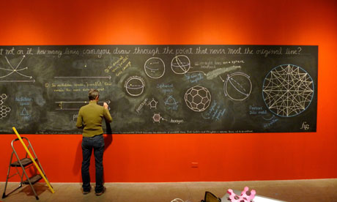
physmath
Physicists are
the artists!

Slide 6
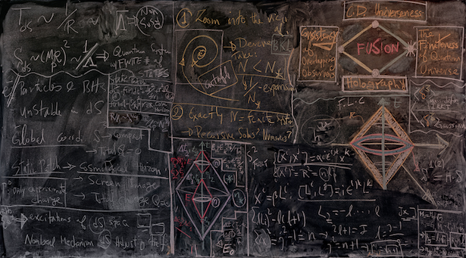

Slide 7
4
5

Slide 8
4

Slide 9
5

Slide 10
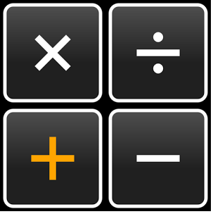
Math operations
Name each of these symbols

Slide 11
Give an example of an everyday situation where you would use each of these symbols
5
6
4
4

Slide 12

Which symbol is missing?

Slide 13
Equals is the most important symbol in physics
It can only be used when two things are definitely completely equal!
If two things are almost equal then they are not equal!

Slide 14
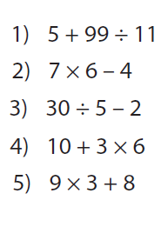
What’s the answer?
Is it 14? Or is it 9.45?

Slide 15
Using math in physics
Order of operations
BIDMAS

Slide 16
BIDMAS Stands for…
Brackets
Indices (Don’t worry about this one for now)
Division
Multiplication
Addition
Subtraction

Slide 17

Showing your working
It’s important to show all steps in a Physics calculation
Set your work out like this:
$5+99 ÷11$
= 5 + 9
= 14

Slide 18
4
5
6

Slide 19
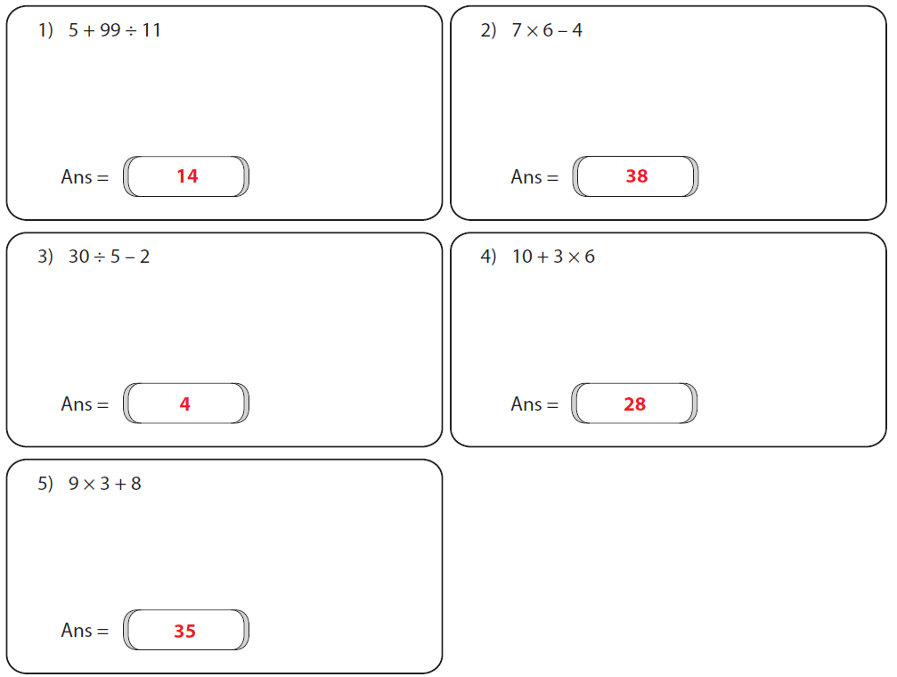
4

Slide 20
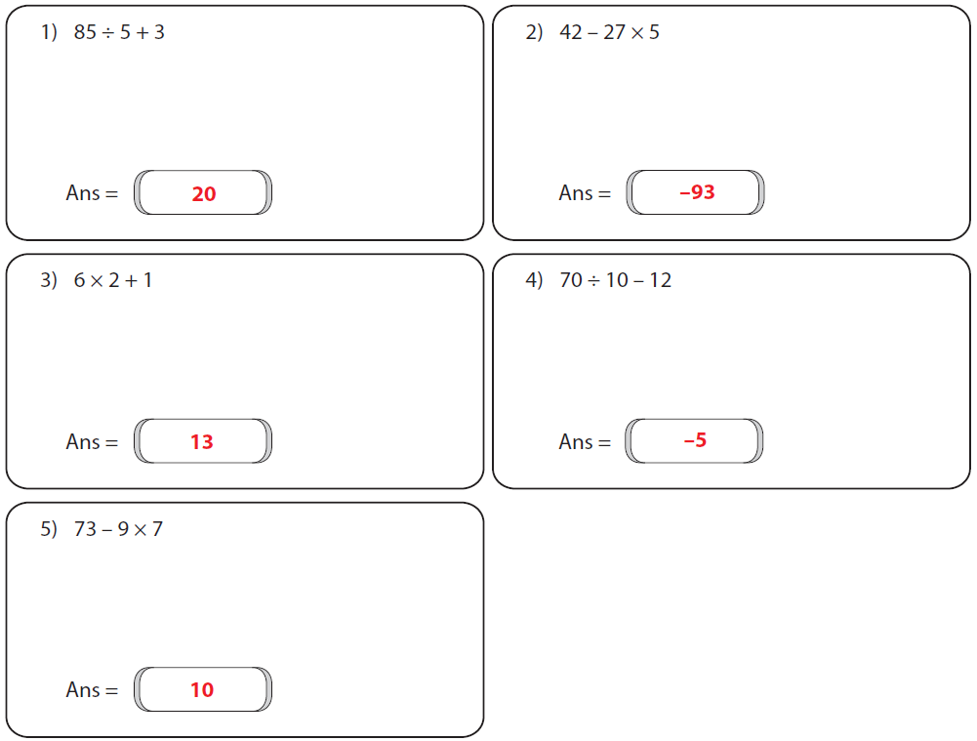
5

Slide 21
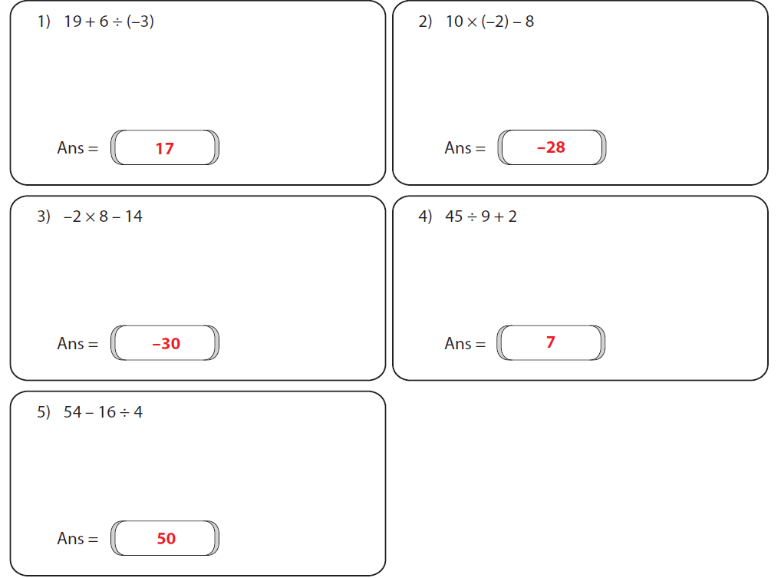
6

Slide 22

Tennis physmath
Two teams
A Question ball is served to a team with 20 seconds to answer
If you get it right, the question ball is returned to the other team
If you get it wrong, the other team a point
Tennis scoring system: 15, 30, 40, game

Slide 23
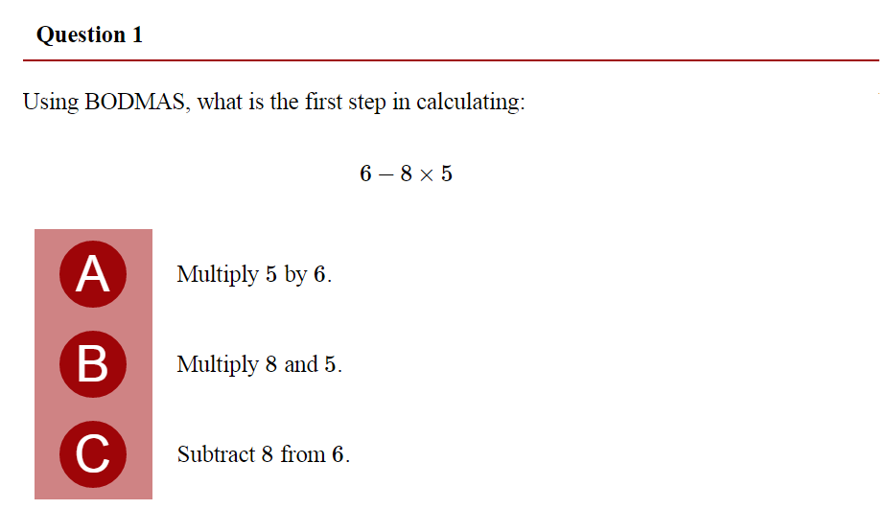

Slide 25
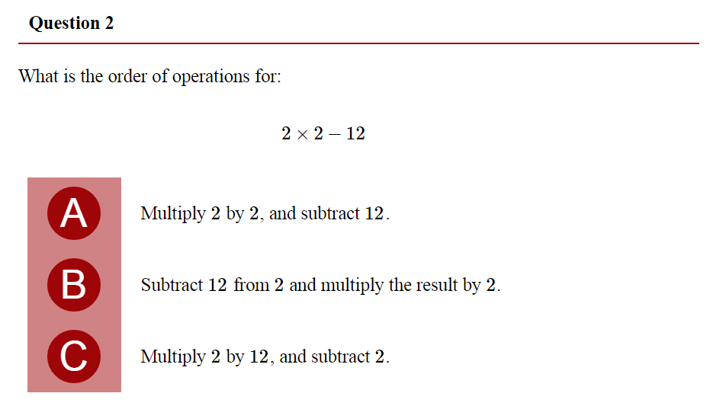

Slide 27
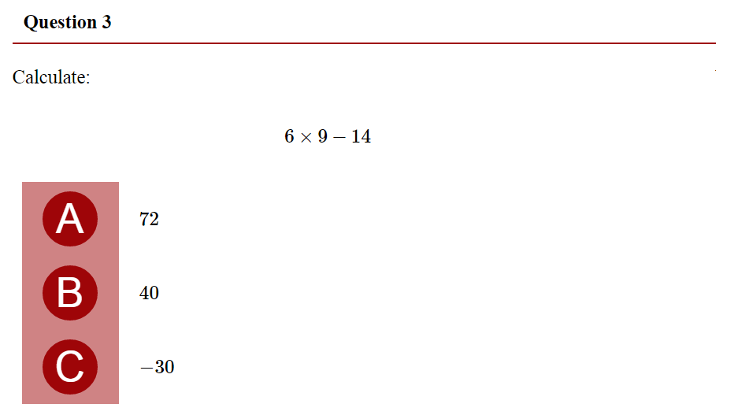

Slide 29
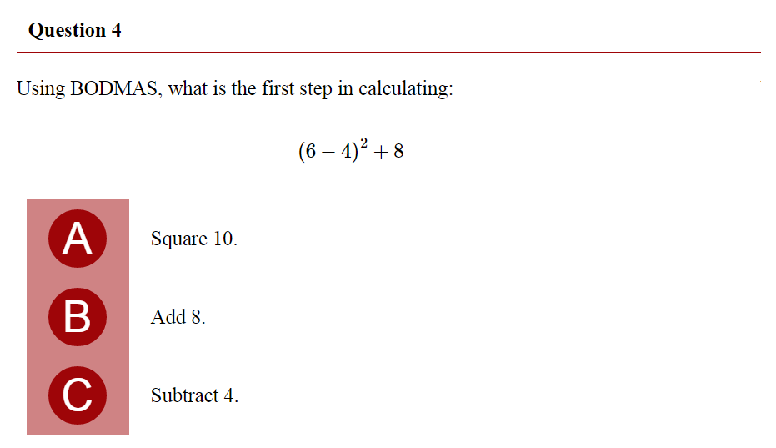

Slide 31
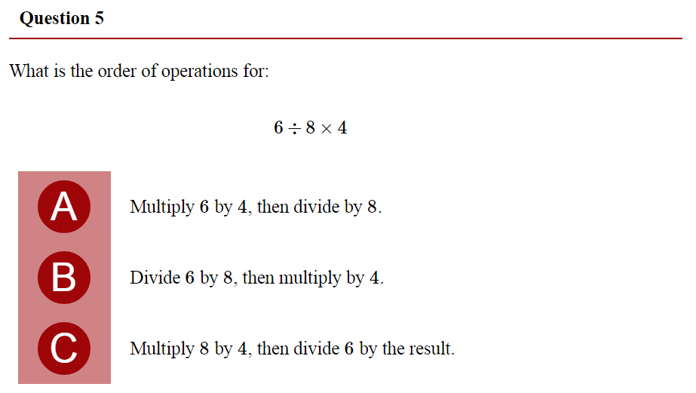

Slide 33
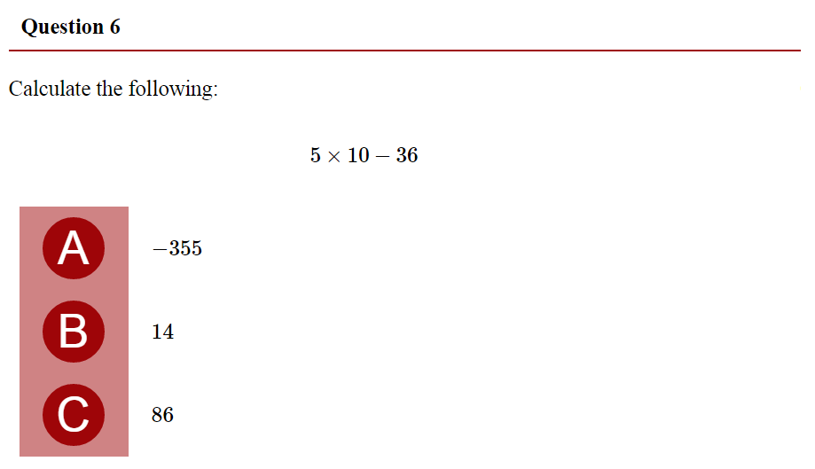

Slide 35
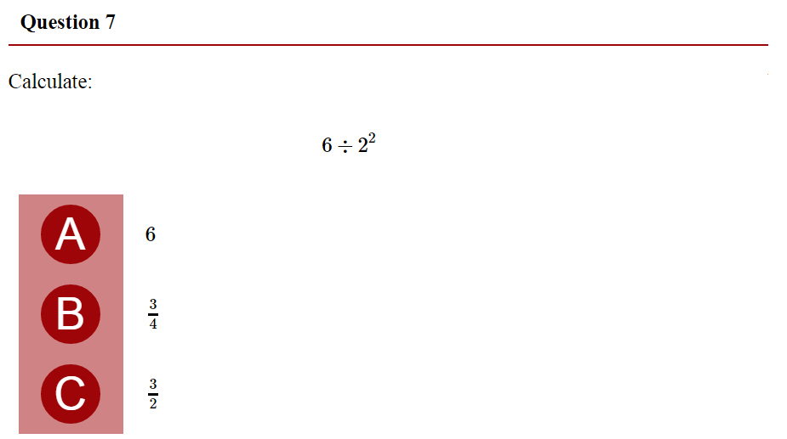

Slide 37
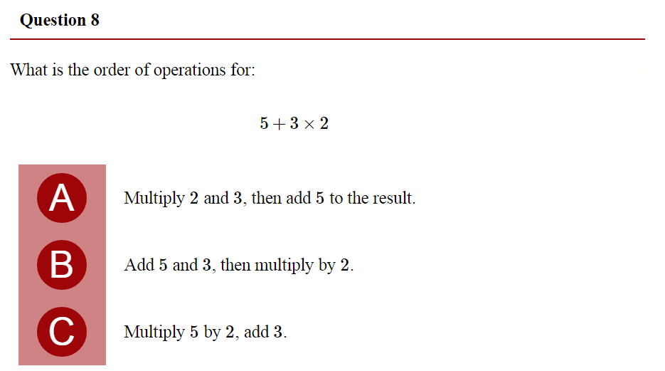

Slide 39
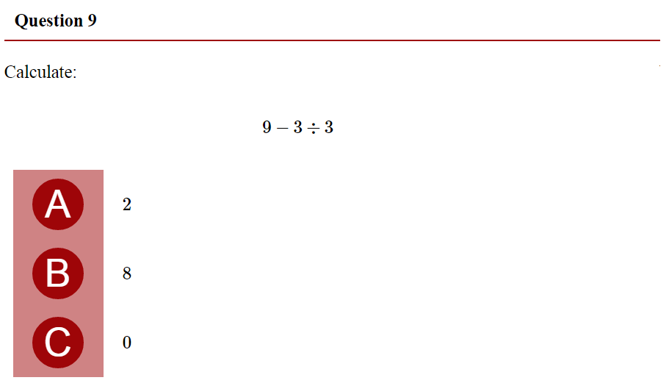

Slide 41
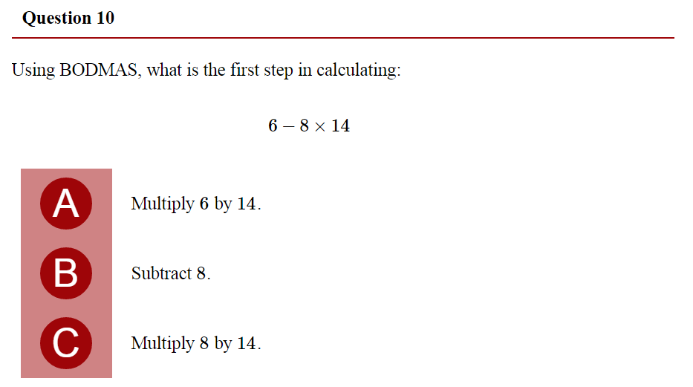

Slide 43

Learning outcomes
  Level 4
  Sort numbers based on their values
  Level 5
  Give an example of where each skill would be needed
  Level 6
  Calculate numerical answers using BIDMASS

