Slide 1
Physmath
2: Fractions and percentages

Slide 2
Learning outcomes
Level 4
Sort fractions and percentages based on their values
Level 5
Match fractions and percentages of equal value
Level 6
Calculate fractions and percentages for real situations

Slide 4
Converting fractions to decimals
In Math they’ll show you a fancy way to do this. In Physics, we’ll use a calculator!

Slide 5
Converting fractions to decimals
Convert each of these into a decimal value by dividing the top by the bottom

Slide 6
Converting fractions to decimals
1.33 1.5 0.91
Can you put these in ascending order?

Slide 7
4
5

Slide 8
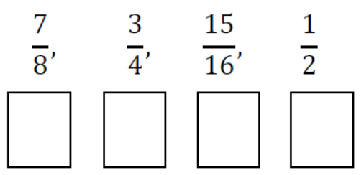
percentages
To convert a decimal to a percentage, you just times by 100 and add a % sign
Convert these to percentages!

Slide 9
Real life scenario questions
Put numbers here!
Put your hand up if you only have a Playstation in your house
Put your hand up if you only have an Xbox in your house
Put your hand up if you have both
Put your hand up if you don’t have a Playstation or Xbox at your house

Slide 10
fractions
Fraction who own Playstations:
Fraction who own Xboxes:
Fraction who own both:
Fraction who don’t own a console:

Slide 11
Percentage
Percentage who own Playstations:
Percentage who own Xboxes:
Percentage who own both:
Percentage who don’t own a console:

Slide 12
In pairs, Write your own yes or no question!
Now go around the classroom and collect data from other students to answer your questions
Now find the fraction and percentages for your question
Add your data to the table on the next slide

Slide 13
Question | # of Yes | # of No | Fraction of Yes | Fraction of No | %of Yes | %of No

Slide 20
Learning outcomes
Level 4
Sort fractions and percentages based on their values
Level 5
Match fractions and percentages of equal value
Level 6
Calculate fractions and percentages for real situations

