Slide 1
Physmath
3: Ratios, reciprocals and rounding

Slide 2
Learning outcomes
Level 4
Define reciprocal
Level 5
Convert numbers to different decimal places
Level 6
Construct a question which requires the use of ratios

Slide 3
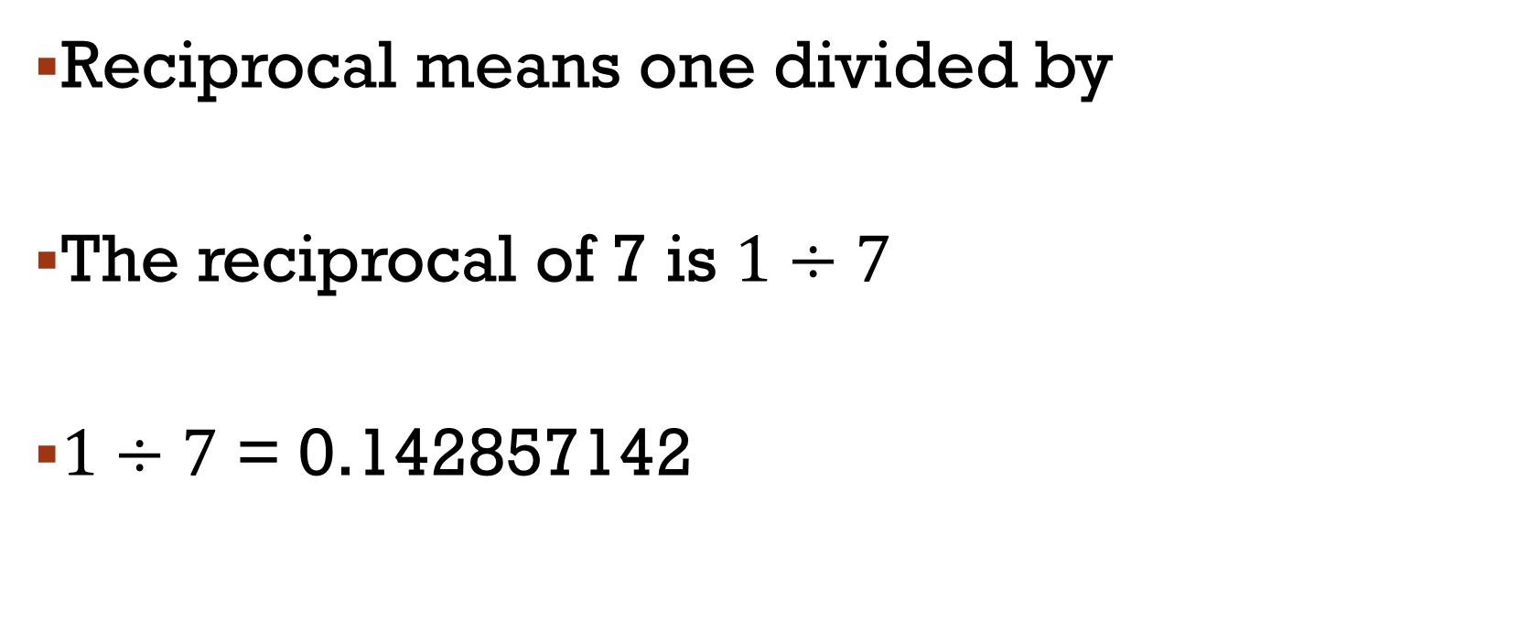
reciprocal
Reciprocal means one divided by
The reciprocal of 7 is $1÷7$
$1÷7$ = 0.142857142

Slide 4
Find the reciprocal of…
8
15
3
0.6
6
12.3
17.95
8.642
4
5
6

Slide 5
Find the reciprocal of…
8
14
4
0.7
6
12.3
17.95
8.642
0.125
0.071428571
0.25
1.428571429
0.16666666666667
0.081300813
0.055710306
0.115713955

Slide 6
Tenth: 1 decimal place (dp)
Hundredth: 2 dp
Thousandth: 3 dp

Slide 9
ratios
Ratios compare two numbers
Teacher : Student
:

Slide 10
In your house
How many people are there?
How many tvs are there?
People : TVs
:

Slide 11
4

Slide 12
4

Slide 13
4

Slide 14
4

Slide 15
5

Slide 16
5

Slide 17
5

Slide 18
5

Slide 19
6

Slide 20
6

Slide 21
6

Slide 22
6

Slide 23
Lesson recap
Write down every key word you can remember from the last 3 lessons without looking back in your book
Now use your book and a different coloured pen to add any words that you forgot about!

Slide 24
How many words did you get without your book?
How many words did you get with your book?
What is the ratio…
Words without book : words with book
:

Slide 25
Learning outcomes
Level 4
Define reciprocal
Level 5
Convert numbers to different decimal places
Level 6
Construct a question which requires the use of ratios

