Slide 1
Physmath
4: Interpreting charts

Slide 2
Learning outcomes
Level 4
Record data in a table
Level 5
Interpret the data in a pie chart and bar chart
Level 6
Calculate the angles required to draw a pie chart

Slide 3
Pendulum experiment
You are going to measure how long it takes for different length pendulums to swing
We will record our data in a table
A table is a type of chart

Slide 4
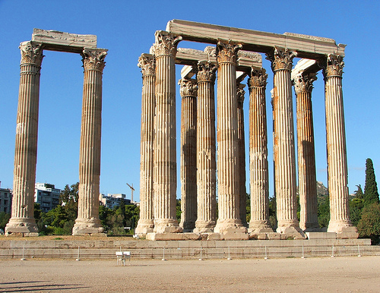

Slide 6
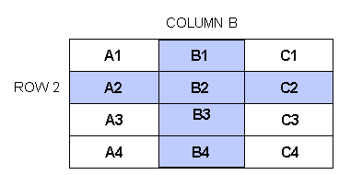

Slide 7
 | 1st Time for 1 swing ( ) |  | 3rd Time for 1 swing ( )
6

Slide 8
Length ( ) | 1st Time for 1 swing ( ) | 2nd Time for 1 swing ( ) | 3rd Time for 1 swing ( ) | Average Time for 1 swing ( )
5

Slide 9
Length (cm) | 1st Time for 1 swing (s) | 2nd Time for 1 swing (s) | 3rd Time for 1 swing (s) | Average Time for 1 swing (s)
4

Slide 10
Key skills for tables!
Tables should be drawn neatly with pencil and ruler
All headings must have a unit
All numbers in a column must be give to equal decimal places

Slide 14
Other types of charts
You could display Jeff’s data in a chart that would be easier to look at quickly
A bar chart!

Slide 15
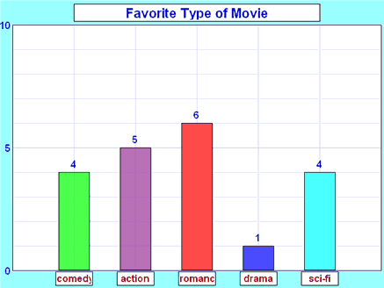

Slide 16
Drawing bar charts
Level 4: Plot a bar chart of Monday’s data
Put the different types of materials along the bottom (x-axis)
Put the number of them up the side! (y-axis)
Level 5: Plot a bar chart for the whole week
Put the different types of materials along the bottom (x-axis)
Put the total number of each material up the side (y-axis)
Level 6: Plot a bar chart of your choice
What could you have on the x and y axis?

Slide 17
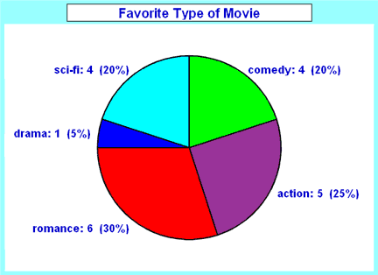

Slide 18
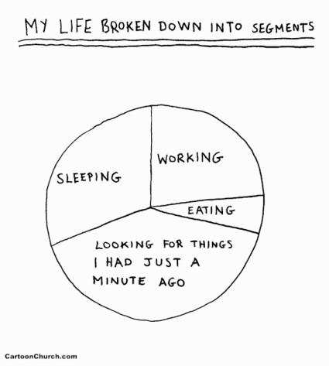

Slide 20
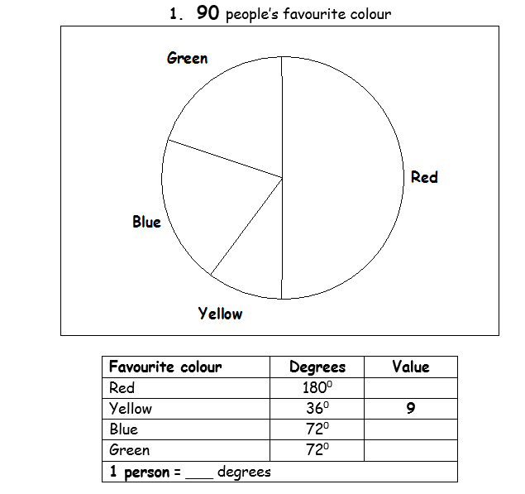
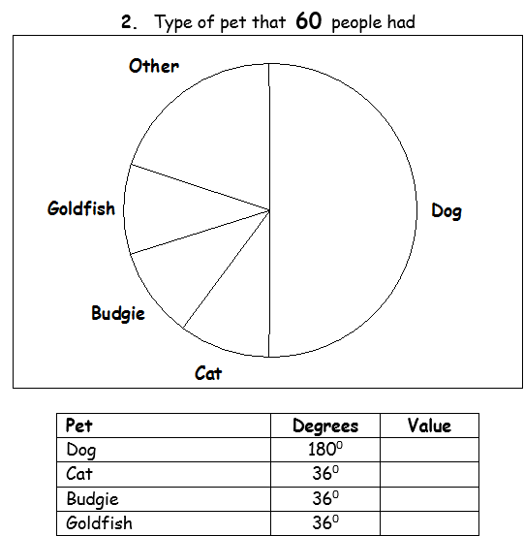

Slide 21
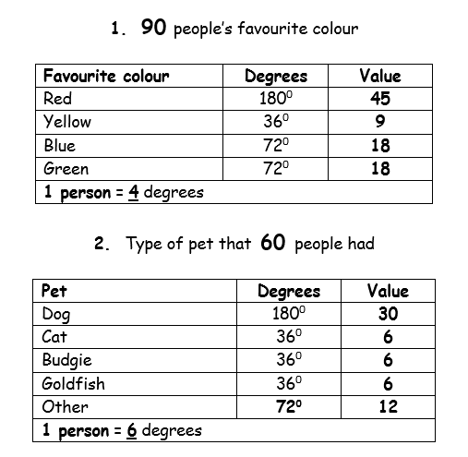

Slide 22
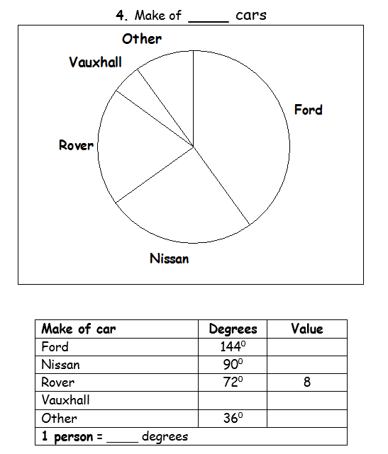
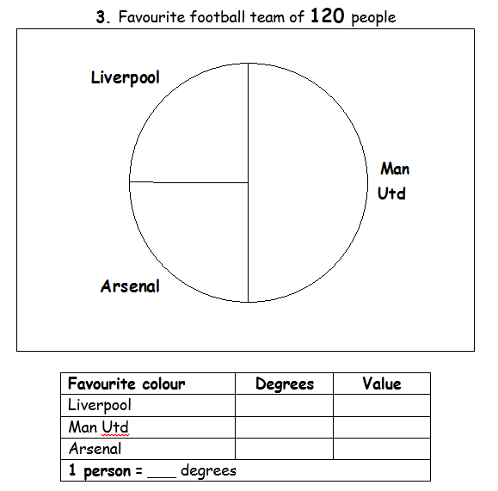

Slide 23
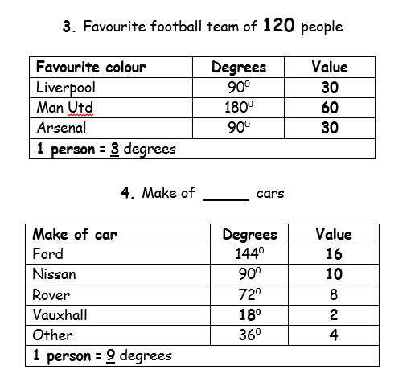

Slide 24
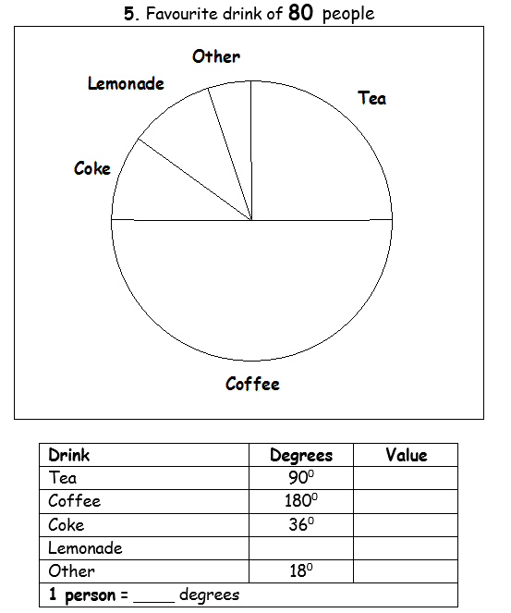
EXTENSION QUESTIONS
5a) What fraction of people said Tea was their favourite drink?
5b) What fraction of people said Lemonade was their favourite drink?
5c) What percentage of people said Coffee was their favourite drink?
5d) What percentage of people said Other was their favourite drink?
5e) What is the probability that a person, chosen at random, said their favourite drink is Coke?
5f) How many of the people asked said that Coke or Lemonade was their favourite drink?

Slide 26
Learning outcomes
Level 4
Record data in a table
Level 5
Interpret the data in a pie chart and bar chart
Level 6
Calculate the angles required to draw a pie chart

