Slide 1
Physmath
7: Units

Slide 2
Learning outcomes
Level 4
Recall ten different units
Level 5
Give an example of quantities with more than one possible unit
Level 6
Relate the choice of unit to the size of the number

Slide 3
Match the blue words to the green words!
Temperature
Decibels
Metres
Force
Newtons
Minutes
Time
Area
Kilograms
Amps
Volume
Distance
Degrees celcius
Metres squared
Noise Level
Mass
Centimetres cubed
Kilometres per hour
Current
Speed

Slide 4
Distance
Metres
Noise Level
Decibels
Mass
Kilograms
Current
Amps
Speed
Kilometres per hour
Temperature
Degrees celcius
Force
Newtons
Time
Minutes
Area
Metres squared
Volume
Centimetres cubed

Slide 5
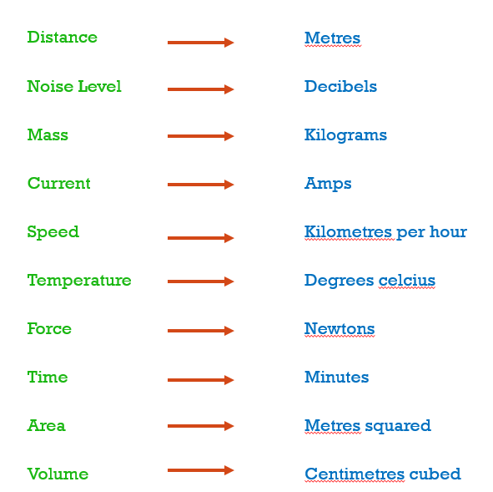
What’s the difference between the words in green and the words in blue?
The green words are physical quantities and the blue words are the units of the quantities

Slide 6
More than one unit
A student says that kilometers per hour is the only legit unit for speed.
Do you agree?
Why or why not?
4
5

Slide 7
What other units can you think of?
Speed
Kilometres per hour

Slide 8
What other units can you think of?
Metres per second
Metres per minute
Speed
Kilometres per hour
Miles per hour
Lightyears per millenia

Slide 9
Can you think of more units for each green physical quantity?
Add as many as you can to your notes
Distance
Metres
Mass
Kilograms
Speed
Kilometres per hour
Temperature
Degrees celcius
Time
Minutes
Area
Metres squared
Volume
Centimetres cubed

Slide 10
Why do we use different units?
Take a small piece of paper
In pairs, brainstorm the reasons why people use different units and write your reason on the piece of paper
Scrunch it up
Throw it in your teacher’s hat!

Slide 11
Why do we use different units?
We do this to make numbers easier to use!
How long is the school day?
1 minute: Think, pair, share

Slide 12
Length of school day
You probably chose hours! Why did you do this?

Slide 13
The school day is around 6 hours
How many minutes is this?
How many seconds is this?
How many weeks is this?
How many years is this?
How many centuries is this?
4
5
6

Slide 14
Extension
6
If a car is travelling along Al Shamal at 80 km/hr, what is it’s speed in:
Miles per hour
Metres per second
(1 mile = 1.6km)

Slide 15
Extension
6
If a car is travelling along Al Shamal at 80 km/hr, what is it’s speed in:
Miles per hour 50 mph
Metres per second 22.2 m/s
(1 mile = 1.6km)

Slide 16
Appropriate units
A car drives from Doha to Dubai and measures the distance travelled.
What is the most appropriate unit to use for the measurement?
Why did you choose this unit?

Slide 17
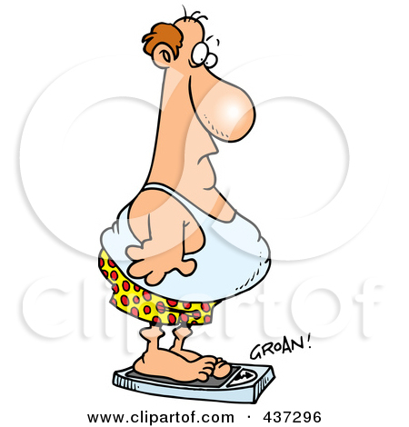
Appropriate units
A person stands on a weighing scale.
What is the most appropriate unit to use for the measurement?
Why did you choose this unit?

Slide 18
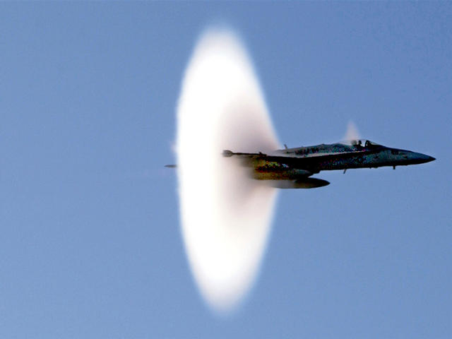
Appropriate units
The speed of a plane is measured
What is the most appropriate unit to use for the measurement?
Why did you choose this unit?

Slide 19
Appropriate units
The speed of a snail is measured
What is the most appropriate unit to use for the measurement?
Why did you choose this unit?

Slide 20
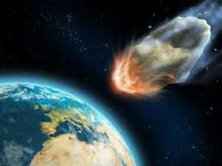
Appropriate units
The speed of an asteroid is measured
What is the most appropriate unit to use for the measurement?
Why did you choose this unit?

Slide 21
Unit game
Pair up
Person A says a physical quantity
Person B replies with a correct unit
Continue until person B gets the wrong unit
Record their winning streak (number of correct answers)
Swap roles and repeat
Highest winning streak wins after 5 minutes

Slide 22
Learning outcomes
Level 4
Recall ten different units
Level 5
Give an example of quantities with more than one possible unit
Level 6
Relate the choice of unit to the size of the number

