Slide 1
8.3 Preparation of salts
Demonstrate knowledge and understanding of preparation, separation and purification of salts as examples of some of the techniques specified in section 2.2.2 and the reactions specified in section 8.1
Demonstrating knowledge and understanding of the preparation of insoluble salts by precipitation
Suggest a method of making a given salt from a suitable starting material, given appropriate information

Slide 2
Mini test – write the formulae for
Nitric acid
Hydrochloric acid
Sulfuric acid
Copper oxide
Potassium nitrate
Lithium hydroxide
Water
Carbon dioxide
Calcium carbonate

Slide 3
What acid would you need…to make the following salts?
copper sulfate
sodium nitrate
calcium chloride
sodium ethanoate.

Slide 4
What alkali or base would you need. …to react with sulfuric acid to make:
Lithium sulfate
Calcium sulfate
Copper sulfate
Magnesium sulfate

Slide 5
PART 1 - soluble salts
To make a soluble salt we replace the H⁺ in an acid with a metal ion.
eg HCl (acid) NaCl (salt)
The most appropriate method to make these is to react the acid with:
the metal itself
an alkali (such as a hydroxide)
a base (such as an oxide or carbonate)

Slide 6
Method 1 - Metal and Acid
This is a direct method for producing a salt.
However – not all metals are suitable.

Slide 7
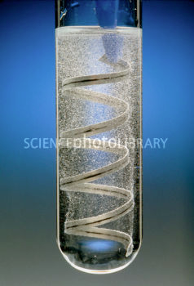
Examples
Mg + 2HCl -> MgCl₂ + H₂
Ca + H₂SO₄ -> CuSO₄ + H₂
Hinge question:
Can you write a sentence to explain why we could NOT make sodium chloride or copper chloride this way?

Slide 8
Take-away tip
The reason you cannot make all salts this way is because:
Some metals are too reactive AND
Others are not reactive enough.

Slide 9
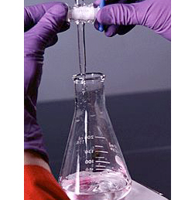
Making salts 2: Acid and Alkali
During a neutralisation reaction acids are neutralised by alkalis to produce a salt and water.
An indicator such as universal indicator, or a pH probe, can be used to show when the acid and alkali have reacted completely.

Slide 10
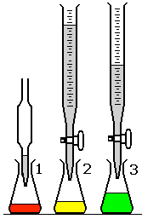
Equipment for acid/alkali neutralisation

Slide 11
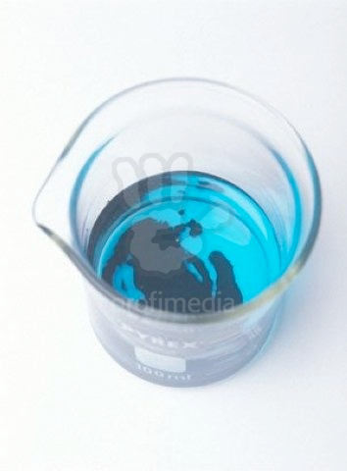
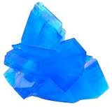
Making salts 3: acid and base
Here an insoluble base such as copper oxide or magnesium oxide reacts with an acid, also neutralising it.
This is the technique we used with copper sulfate.
The base is added to the acid until no more will react and the excess solid is filtered off.
The solution can be left to crystallise

Slide 12
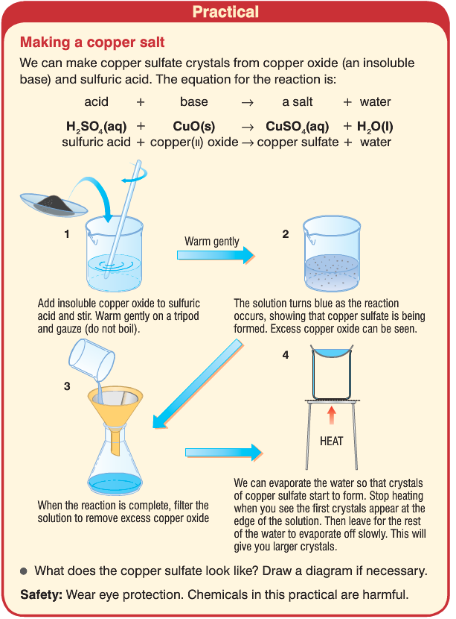

Slide 13
Making salts 4: carbonates
Carbonates are also insoluble solids that react with acid to produce a salt, water and also carbon dioxide.
CaCO₃ + H₂SO₄ -> CaSO₄ + CO₂ + H₂O

Slide 14
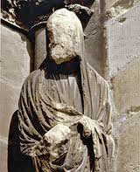
Linked in
Can you use your knowledge of carbonates with acids and your knowledge of limestone to explain this:

Slide 15
PART 2: making insoluble salts
Insoluble salts can be made by mixing appropriate solutions of ions so that a precipitate is formed.
Eg
BaCl₂ (aq) + Na₂SO₄(aq) -> BaSO₄ (s) + 2NaCl (aq)

Slide 16
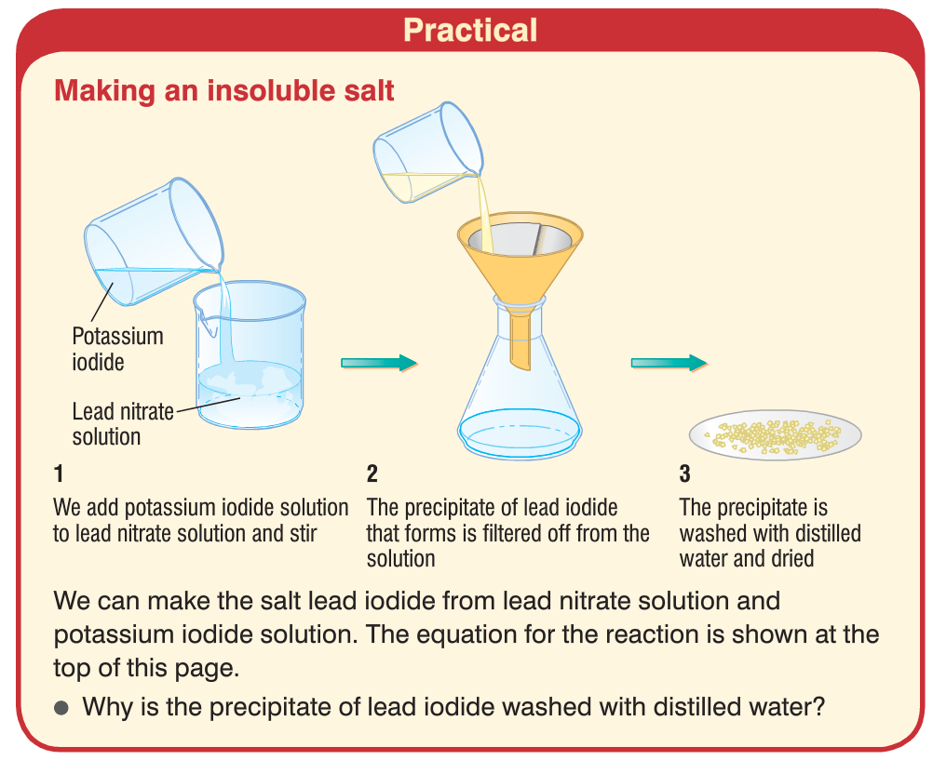

Slide 17
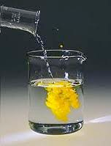
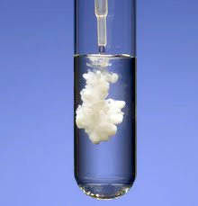
What is a precipitate?
This is a solid formed, suspended in a solution

Slide 18
Barium salts
All barium salts are toxic they are harmful when they dissolve in your stomach and travel around the body.
Why do you think a barium meal does not kill you but can be used in hospitals to add detail to x-rays of soft tissue?

Slide 19
Ammonia
Ammonia dissolves in water and the following reaction occurs:
NH₃(l) + H₂O(l) -> NH₄⁺(aq) + OH⁻(aq)
What pH do you think this solution would have?
High pH eg 9/10 because this is an alkali

Slide 20
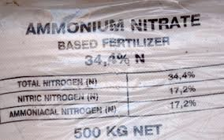
Fertilisers
When ammonia reacts with acids it forms salts such as ammonium chloride, ammonium nitrate, ammonium sulfate.
These salts are important fertilisers.

