Slide 1
Physmath
8: Unit prefixes

Slide 2
Learning outcomes
Level 4
Recall the prefix symbols and values of milli, centi, kilo, mega, giga and tera
Level 5
Convert between unit prefixes
Level 6
Explain why unit prefixes are used in everyday life

Slide 3
Name…
Lit
3 units for time
3 units for distance
3 units for speed

Slide 4
KILO!
What’s the difference between a kilometre and a metre?
What’s the difference between a kilogram and a gram?
Can you think of any other words that begin with kilo?

Slide 5
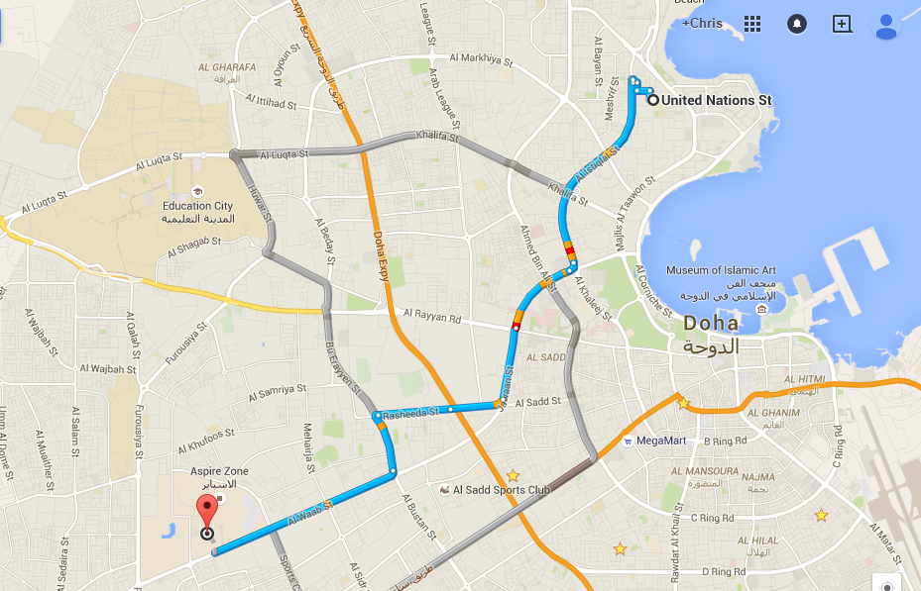
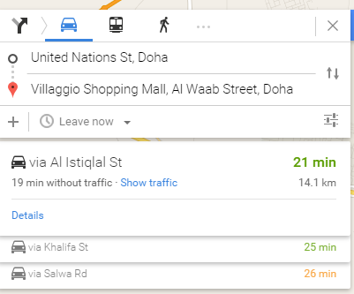
Kilo means 1000!
So when you say that Villagio is 14 kilometres away from school, what you’re really saying is that Villagio is 14 thousand metres away from school

Slide 6
Unit prefixes
Lit
Prefix means something that goes before a word
Eg. Grandfather means your parent's father
In Physics, we use prefixes to change the value of numbers
Eg. Kilometre means one thousand metres

Slide 7
What other prefixes could go in front of the word
‘metre’?
2 minutes: Think, pair, share

Slide 8
You probably came up with…
Centi
Milli
How big is a centimetre compared to a metre?
How big is a millimetre compared to a metre?

Slide 9
Computer storage
You’ve probably heard of the byte, which is the unit of information storage
Have you heard of kilobyte?
Can you put any other prefixes in front of the word byte?
1 min: Individual

Slide 10
Prefix | Symbol | Value in words | Numerical value
Milli | m | Thousandth | 0.001
Centi | c | Hundredth | 0.01
Kilo | k | Thousand | 1000
Mega | M | Million | 1 000 000
Giga | G | Billion | 1 000 000 000
Tera | T | Trillion | 1 000 000 000 000

Slide 11
Convert the following
15km to metres
280Gm to metres
300 ms to seconds
4kg to grams
50 Ms to seconds
60 km/hr to m/hr
20 Mm/min to m/min
100 km/hr to km/min
80 km/min to km/s
900 km/hr to m/s
4
Extension
Give examples of objects which would have physical quantities of this size
eg. Q1 could be the distance from your house to school
5
6

Slide 12
Convert the following
15km to metres
280Gm to metres
300 ms to seconds
4kg to grams
50 Ms to seconds
60 km/hr to m/hr
20 Mm/min to m/min
120 km/hr to km/min
90 km/min to km/s
900 km/hr to m/s
15 000 m
280 000 000 000 m
0.3 s
4000 g
50 000 000 s
60 000 m/hr
20 000 000m/min
2 km/min
90 km/min to 1.5 km/s
250 m/s
4
5
6

Slide 13
Plenary
Write a two sentence summary which explains why Physicists use prefixes
Share your ideas with the class

Slide 14
This was from last lesson!
So why do use different prefixes?
They also make numbers easier to use!

Slide 15
Learning outcomes
Level 4
Recall the prefix symbols and values of kilo, mega, giga and tera
Level 5
Convert between unit prefixes
Level 6
Explain why unit prefixes are used in everyday life

