Slide 1
Combustion
Low/Medium Objectives
For 5 lesson block
Name the common pollutants in the air
State the source of each of these pollutants.
Describe and explain the presence of oxides of nitrogen in car engines and their catalytic removal.
Lesson 21
MrMortonScience

Slide 2
Combustion
High level
Objectives
For 5 lesson block
From iGCSE specification
Name the common pollutants in the air as being carbon monoxide, sulfur dioxide, oxides of nitrogen and lead compounds
State the source of each of these pollutants:
– carbon monoxide from the incomplete combustion of carbon-containing substances
– sulfur dioxide from the combustion of fossil fuels which contain sulfur compounds (leading to ‘acid rain’)
– oxides of nitrogen from car engines
– lead compounds from leaded petrol
Describe and explain the presence of oxides of nitrogen in car engines and their catalytic removal
MrMortonScience

Slide 3
Combustion
Write down in your books what you think combustion means.

Slide 4
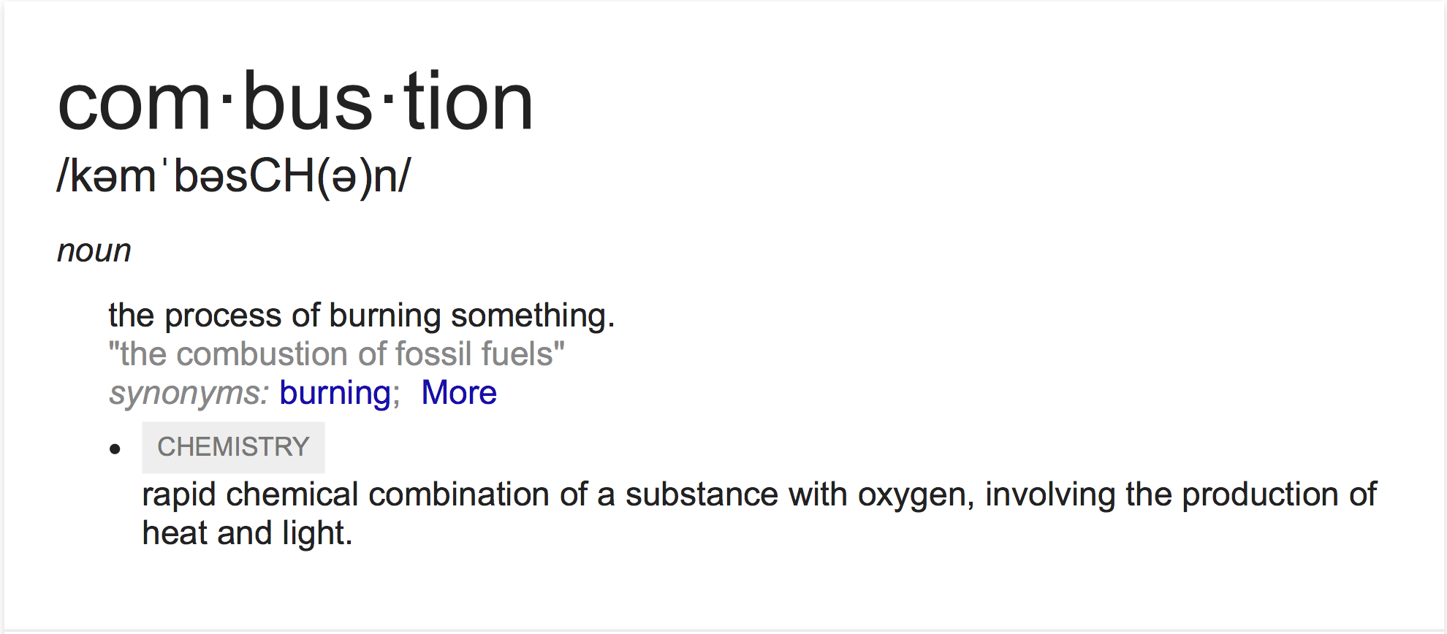
Combustion
From Google dictionary
This is close to what we want in chemistry

Slide 5
Combustion
By chemical combination it means REACTION

Slide 6
Combustion
Usually a fuel

Slide 7
Combustion
ALWAYS OXYGEN!!!

Slide 8
Combustion
This makes it an exothermic reaction

Slide 9
إهتياج عنيف

Slide 12
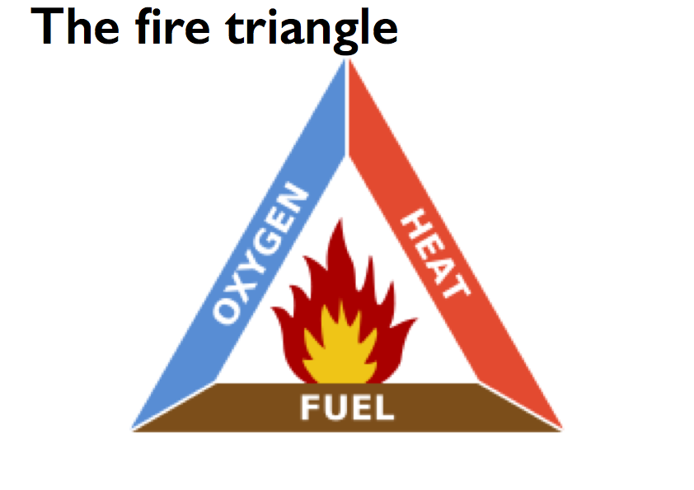

Slide 17
Molecular formula
REMINDER!!
The molecular formula tells us how many atoms are in a compound.
O
In this molecule are 2 atoms of hydrogen (H) and one atom of oxygen (O)
H
H
We write this as H2O
this number has to be small

Slide 18
Common mistakes
REMINDER!!
O
2H2O
H
H
O
a number here means 2 molecules of water
H
H

Slide 19
Common mistakes
REMINDER!!
O
HO2
O
H
a number here means 2 atoms of oxygen - a different compound

Slide 20
Common mistakes
REMINDER!!
H
H2O2
O
O
H
This would also be a different chemical, because it would have two oxygen atoms and two hydrogen atoms.

Slide 21
Molecular formula
KEY
H
hydrogen atoms
H
H
H2
O
O
oxygen atoms
H2O
H
H
C
carbon atoms
O
C
O
CO2
N
nitrogen atoms
H
NH3
N
H
H
H
H
CH4
C
H
H

Slide 22
Can you give the Molecular formula?
KEY
H
hydrogen atoms
O
O
O
oxygen atoms
C
carbon atoms
C
O
N
nitrogen atoms
N
N
H
H
C
C
H
H

Slide 23
Naming compounds
Step 1 - identify the atoms
O
H
H

Slide 24
Naming compounds
Step 1 - identify the atoms
O
H = hydrogen
a compound with hydrogen
is hydrous or a hydride
H
H
O = oxygen
a compound with oxygen
is an oxide

Slide 25
Naming compounds
Step 2 - count the atoms
O
1 oxygen atom
2 hydrogen atoms
H
H
2 atoms is called di-

Slide 26
Naming compounds
Step 3 - put it all together
O
di hydrous oxide
H
H
means 2 hydrogen atoms
& 1 oxygen atom
the common name for this compound is water

Slide 27
NAME THE COMPOUND
KEY
hydrogen gas
(element)
H
hydrogen atoms
H
H
O
water
(di-hydrous oxide)
O
oxygen atoms
H
H
C
carbon atoms
O
C
O
carbon dioxide
N
nitrogen atoms
H
ammonia
(tri-hydrous nitride)
N
Remember
H
H
mon - 1
di - 2
tri - 3
H
H
methane
C
H
H

Slide 28
Combustion Equations
1. Word equation with state symbols
hydrogen(g) + oxygen(g) —> water(g)

Slide 29
Combustion Equations
1. Word equation with state symbols
hydrogen(g) + oxygen(g) —> water(g)

Slide 30
Combustion Equations
1. Word equation with state symbols
hydrogen(g) + oxygen(g) —> water(g)

Slide 31
Combustion Equations
1. Word equation with state symbols
hydrogen(g) + oxygen(g) —> water(g)
2. Replace words with symbols
H2(g) + O2(g) —> H2O(g)

Slide 32
Combustion Equations
1. Word equation with state symbols
hydrogen(g) + oxygen(g) —> water(g)
2. Replace words with symbols
H2(g) + O2(g) —> H2O(g)

Slide 33
Combustion Equations
1. Word equation with state symbols
hydrogen(g) + oxygen(g) —> water(g)
2. Replace words with symbols
H2(g) + O2(g) —> H2O(g)

Slide 34
Combustion Equations
1. Word equation with state symbols
hydrogen(g) + oxygen(g) —> water(g)
2. Replace words with symbols
H2(g) + O2(g) —> H2O(g)
2. Draw the particle diagrams
H
H

Slide 35
Combustion Equations
1. Word equation with state symbols
hydrogen(g) + oxygen(g) —> water(g)
2. Replace words with symbols
H2(g) + O2(g) —> H2O(g)
2. Draw the particle diagrams
O
O
H
H

Slide 36
Combustion Equations
1. Word equation with state symbols
hydrogen(g) + oxygen(g) —> water(g)
2. Replace words with symbols
H2(g) + O2(g) —> H2O(g)
2. Draw the particle diagrams
O
O
O
H2(g) + O2(g) —> H2O(g)
H
H
H
H

Slide 37
2. Replace words with symbols
2. Draw the particle diagrams
Combustion Equations
hydrogen(g) + oxygen(g) —> water(g)
H2(g) + O2(g) —> H2O(g)
4. Balance the particle diagram first
O
O
O
H2(g) + O2(g) —> H2O(g)
H
H
H
H

Slide 38
2. Replace words with symbols
2. Draw the particle diagrams
Combustion Equations
hydrogen(g) + oxygen(g) —> water(g)
H2(g) + O2(g) —> H2O(g)
4. Balance the particle diagram first
O
O
O
H2(g) + O2(g) —> H2O(g)
H
H
H
H
But the reactants have 2 oxygen atoms
The products have 1 oxygen atom

Slide 39
2. Replace words with symbols
2. Draw the particle diagrams
Combustion Equations
hydrogen(g) + oxygen(g) —> water(g)
H2(g) + O2(g) —> H2O(g)
4. Balance the particle diagram first
O
O
O
O
H2(g) + O2(g) —> H2O(g)
H
H
H
H
H
H
Now the oxygens balance
We multiply this molecule by 2

Slide 40
2. Replace words with symbols
2. Draw the particle diagrams
Combustion Equations
hydrogen(g) + oxygen(g) —> water(g)
H2(g) + O2(g) —> H2O(g)
4. Balance the particle diagram first
O
O
O
O
H2(g) + O2(g) —> H2O(g)
H
H
H
H
H
H
H
H
We need more hydrogen atoms on this side so we add another hydrogen molecule
But the hydrogens do not

Slide 41
2. Draw the particle diagrams
Combustion Equations
hydrogen(g) + oxygen(g) —> water(g)
H2(g) + O2(g) —> H2O(g)
4. Balance the particle diagram first
O
O
O
O
H2(g) + O2(g) —> H2O(g)
H
H
H
H
H
H
H
H
5. Balance the symbol equationn to match
NOW we have the same atoms on both side of the equation

Slide 42
2. Draw the particle diagrams
Combustion Equations
hydrogen(g) + oxygen(g) —> water(g)
2H2(g) + O2(g) —> H2O(g)
4. Balance the particle diagram first
O
O
O
O
H2(g) + O2(g) —> H2O(g)
H
H
H
H
H
H
H
H
5. Balance the symbol equationn to match

Slide 43
2. Draw the particle diagrams
Combustion Equations
hydrogen(g) + oxygen(g) —> water(g)
2H2(g) + O2(g) —> 2H2O(g)
4. Balance the particle diagram first
O
O
O
O
H2(g) + O2(g) —> H2O(g)
H
H
H
H
H
H
H
H
5. Balance the symbol equationn to match
remember a number here means 2 molecules of water

Slide 44
Combustion Equations
1. Word equation with state symbols
carbon(s) + oxygen(g) —> water(g)

Slide 45
Combustion Equations
1. Word equation with state symbols
carbon(s) + oxygen(g) —> water(g)

Slide 46
Combustion Equations
1. Word equation with state symbols
carbon(s) + oxygen(g) —> carbon dioxide(g)

Slide 47
Combustion Equations
1. Word equation with state symbols
carbon(s) + oxygen(g) —> carbon dioxide(g)
2. Replace words with symbols
C(s) + O2(g) —> H2O(g)

Slide 48
Combustion Equations
1. Word equation with state symbols
carbon(s) + oxygen(g) —> carbon dioxide(g)
2. Replace words with symbols
C(s) + O2(g) —> H2O(g)

Slide 49
Combustion Equations
1. Word equation with state symbols
carbon(s) + oxygen(g) —> carbon dioxide(g)
2. Replace words with symbols
C(s) + O2(g) —> CO2(g)

Slide 50
Combustion Equations
1. Word equation with state symbols
carbon(s) + oxygen(g) —> carbon dioxide(g)
2. Replace words with symbols
C(s) + O2(g) —> CO2(g)
2. Draw the particle diagrams
C

Slide 51
Combustion Equations
1. Word equation with state symbols
carbon(s) + oxygen(g) —> carbon dioxide(g)
2. Replace words with symbols
C(s) + O2(g) —> CO2(g)
2. Draw the particle diagrams
C
O
O

Slide 52
Combustion Equations
1. Word equation with state symbols
carbon(s) + oxygen(g) —> carbon dioxide(g)
2. Replace words with symbols
C(s) + O2(g) —> CO2(g)
2. Draw the particle diagrams
C
O
O
O
C
O
H2(g) + O2(g) —> H2O(g)

Slide 53
2. Replace words with symbols
2. Draw the particle diagrams
Now you try, can you use what you have learned to make the word, symbol and particle equations for the combustion these fuels to make carbon dioxide and water.
H
H
H
H
H
H
C
C
C
C
C
H
H
H
H
H
H
H
H
Methane CH4
Butane C4H10
H
H
C
C
H
H
C
C
O
H
H
H
H
Ethene C2H4
H
H
Ethanol C2H5OH

Slide 54
Extension: If there is not enough oxygen remember that the combustion produces carbon monoxide instead.
Can you produce balanced incomplete combustion equations for these fuels as well.

