Slide 1
Combustion Practical 2
CWK
To analyse the results of an investigation
To evaluate an investigation
Lesson 23
MrMortonScience

Slide 2
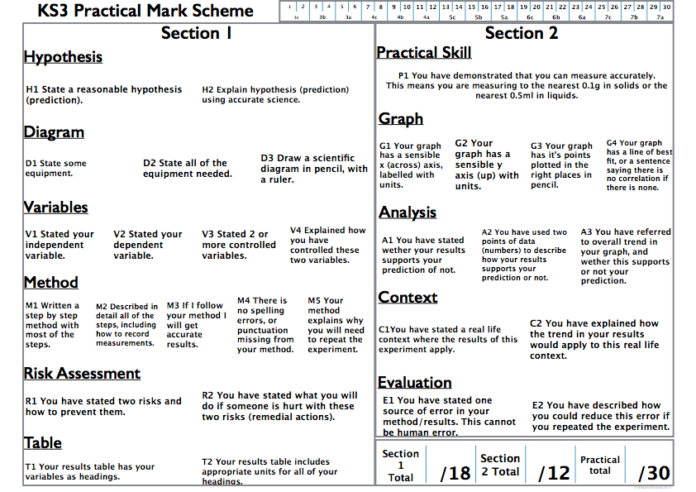

Slide 3
Visually assessed by the teacher in the lesson, this mark is awarded to students who demonstrate that they can carry out a practical safely and accurately.

Slide 7
examples of contexts for this experiment are:

Slide 8
eg firefighters closing doors
or CO2 fire extinguishers

