Slide 1
Metal Carbonates Part 1
CWK
Date
Outline the methods used to prepare metal salts
Know what happens when metal carbonates react with acids
Lesson 11
MrMortonScience

Slide 2
Investigating metal carbonates reaction with acid

Slide 3
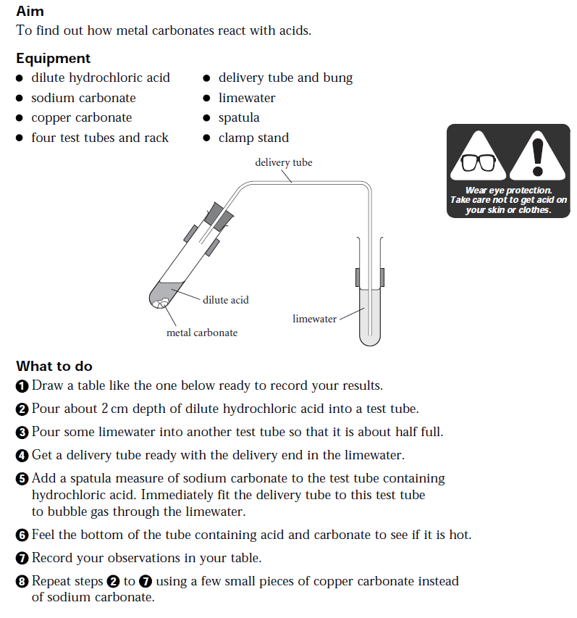

Slide 4
