Slide 1
Advantages and Disadvantages of Quarrying
CWK
CWK
Describe briefly the uses if limestone and how it is quarried.
Consider and evaluate the environmental, social and economic effects of exploiting limestone and producing building materials from it.
Evaluate the developments in using limestone, cement and concrete as building materials, and their advantages and disadvantages over other materials.
Lesson 17
MrMortonScience

Slide 2
What is Limestone?
What is it good for? huh

Slide 3
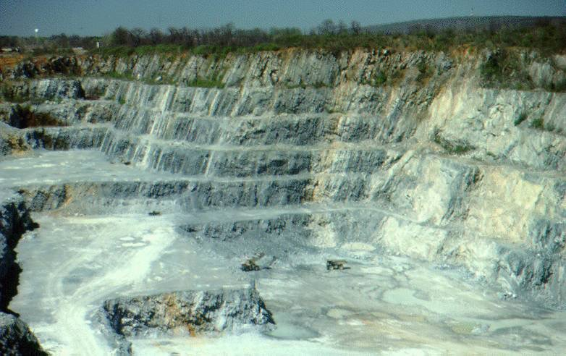
Limestone quarry

Slide 4
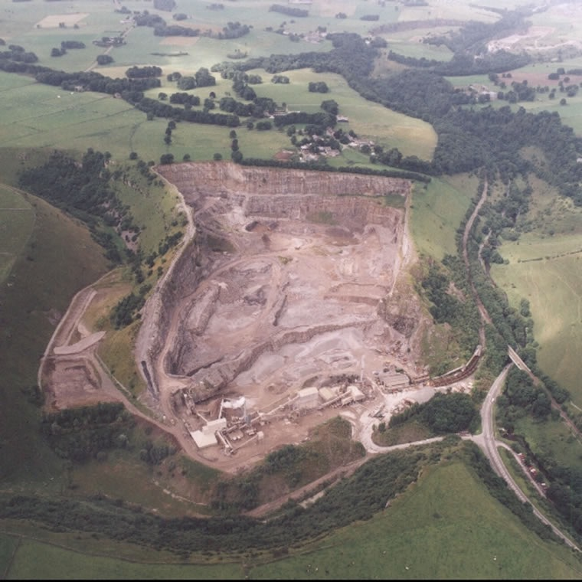
Topley Pike quarry in the Peak District National Park

Slide 5
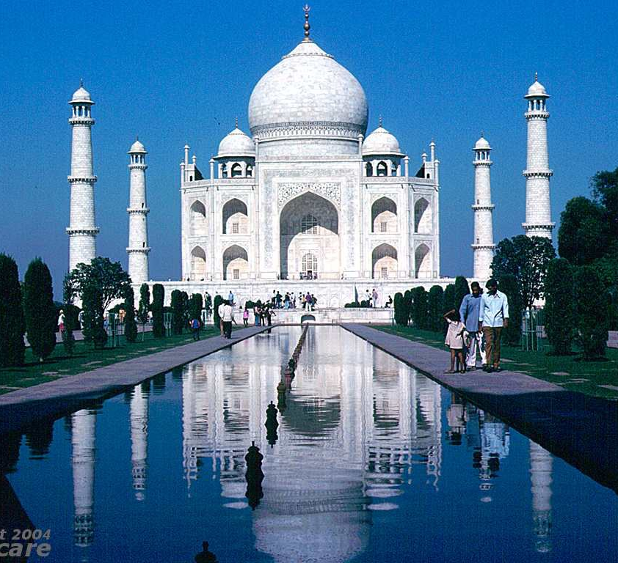
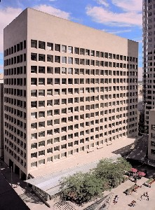
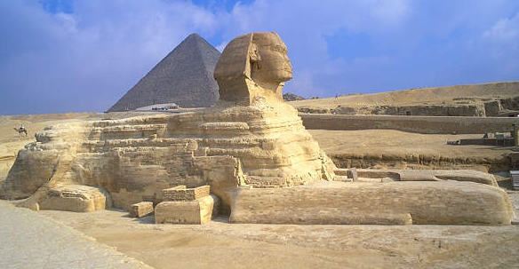
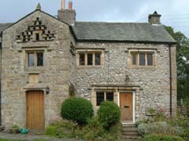
All built with limestone

Slide 6
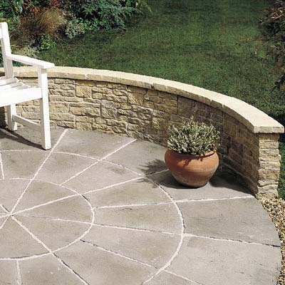
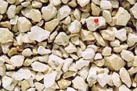
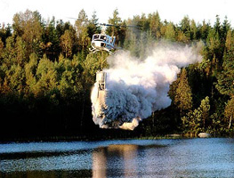
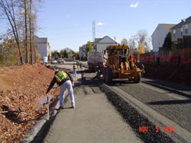
Paving
Chippings
To neutralise acidic lakes
Chippings in roads

Slide 7
CaCO₃ → CaO + CO₂
calcium carbonate calcium oxide
(limestone) (quicklime)
CaO + H₂O → Ca(OH)₂
calcium oxide calcium hydroxide
(quicklime) (slaked lime)

Slide 8
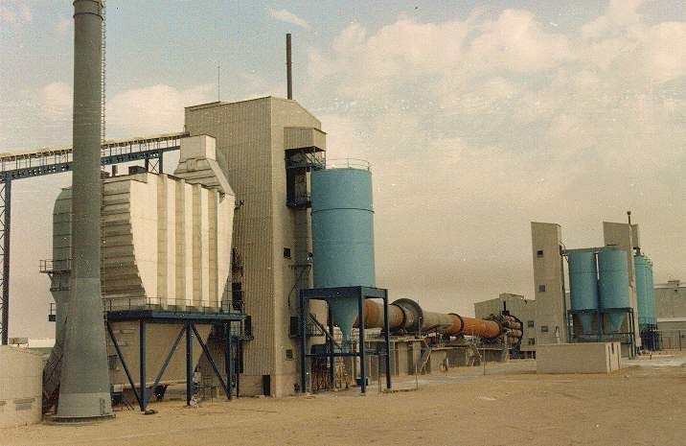
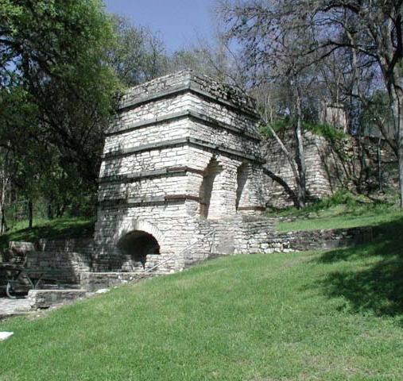
Lime kilns
(old and new)

Slide 9
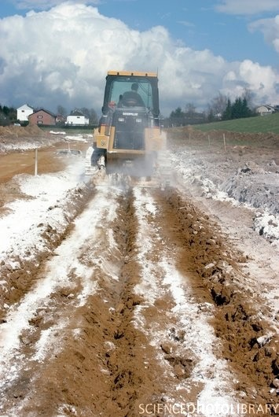
Farmer spreading calcium hydroxide to neutralise acidic soil

Slide 10
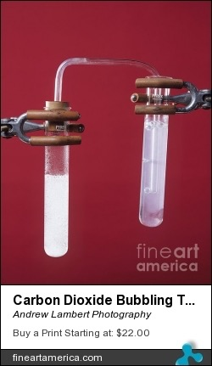
Testing for CO₂ with limewater
Limewater = calcium hydroxide solution
Testing for CO₂ with limewater
(calcium hydroxide solution)

Slide 11
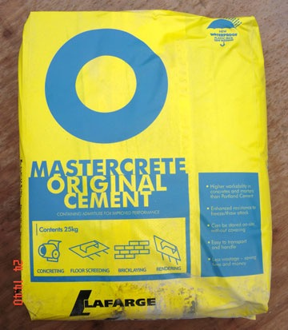
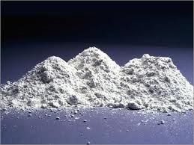
Powdered
limestone
+
Powdered
clay
Heat in rotary kiln
CEMENT

Slide 12
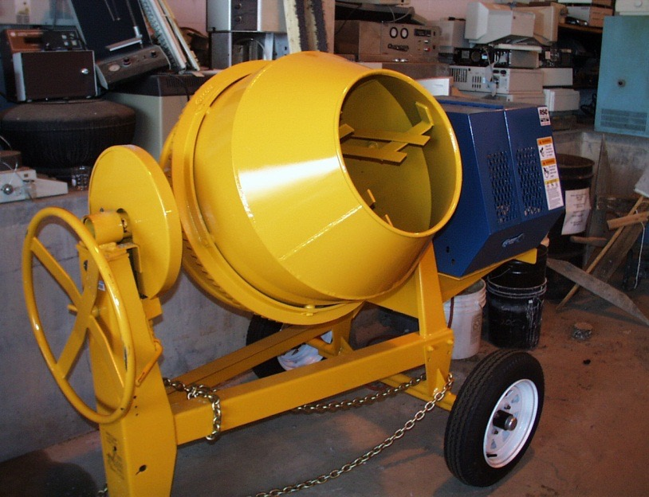
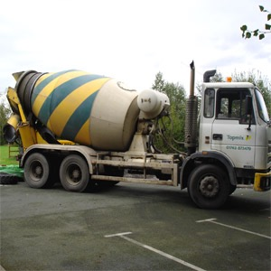
Cement
+
Sand
+
Water
+
Crushed rock
CONCRETE

Slide 13
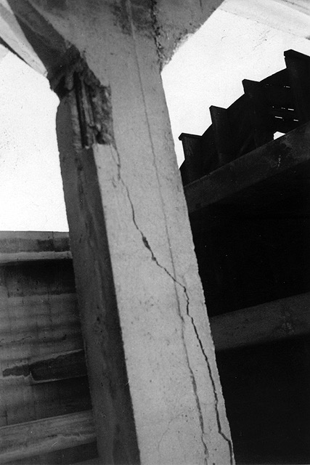
Concrete can break if stretched or bent

Slide 14
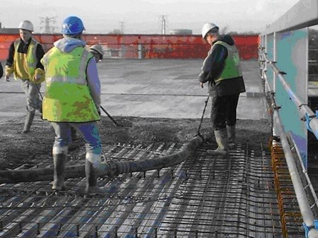
Steel reinforced concrete

Slide 15
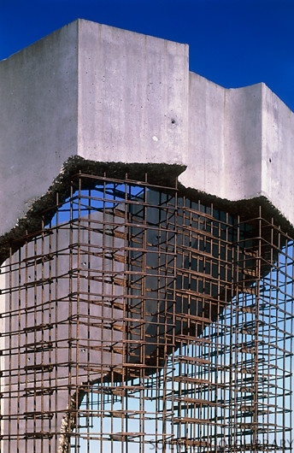
Steel reinforced concrete

Slide 16
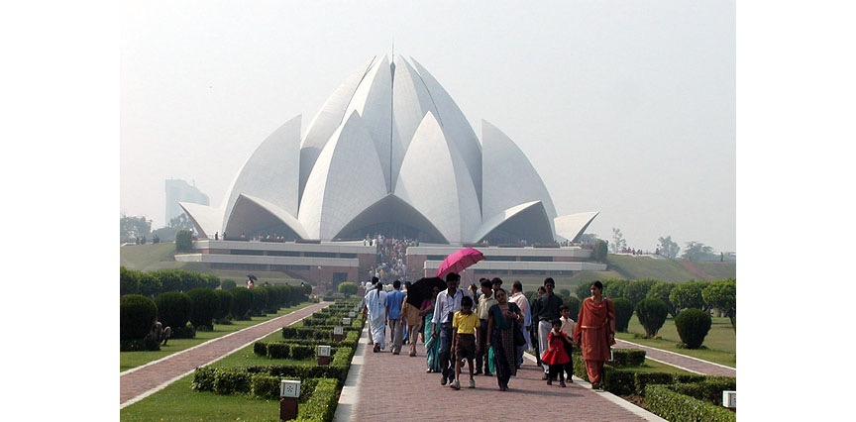
Bahai Lotus Temple in Delhi, India – made of concrete (1980)

Slide 17
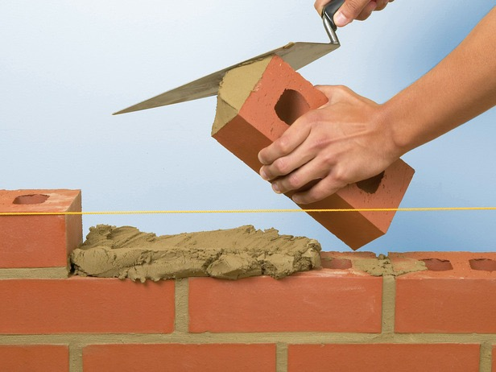
Cement
+
Sand
+
Water
MORTAR

Slide 18
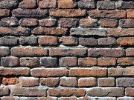
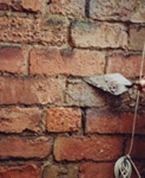
Mortar weathers and brickwork must be re-pointed.

Slide 19
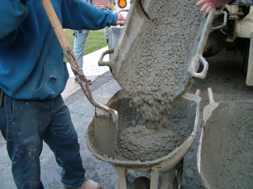
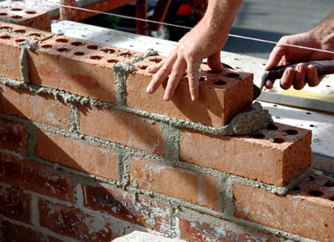
CONCRETE
MORTAR
In a plastic cup, mix together:
1 teaspoon of sand
3 teaspoons of cement
5 teaspoons of gravel
Mix in water until a it all mixes together – do not add too much water
In a plastic cup, mix together:
1 teaspoon of sand
3 teaspoons of cement
Mix in water until a it all mixes together – do not add too much water

Slide 20
Quarrying is Good for Qatar
Reasons For:
Reasons Against:

Slide 21
Computer room or devices lesson - pupils research and prepare their own debate arguments

