Slide 1
Structure of the Earth (layers)
CWK
CWK
To be able to label the core, mantle and crust, and atmosphere.
To describe the properties of the layers if the Earth.
To relate the properties to those of solids, liquids and gases.
Lesson 1
MrMortonScience

Slide 2
Structure of the Earth
cwk
date
Starter: Think Pair Share
How is the Earth like an onion?
Notice that the Earth has a capital ‘E’

Slide 3
Structure of the Earth
cwk
date
Task
How is the Earth like an onion?
Because it has layers….

Slide 4
Atmosphere

Slide 5
Structure of the Earth (layers)
CWK
CWK
To be able to label the core, mantle and crust, and atmosphere.
To describe the properties of the layers if the Earth.
To relate the properties to those of solids, liquids and gases.
Lesson 1
MrMortonScience

Slide 6
Structure of the Earth
cwk
date
Task
What state are the layers of the Earth?
Why?
How does this affect their properties?

Slide 7
Structure of the Earth
cwk
date
Task
What state are the layers of the Earth?
Layer | Thickness | State
Atmosphere
Crust
Mantle
Outer Core
Inner Core |  |  | Nickel & Iron

Slide 8
Structure of the Earth
cwk
date
Task
Draw a diagram of the Earth and it’s layers

Slide 9
Structure of the Earth
cwk
date
Plenary
Describe the Earth’s layers,explain with examples how they're properties are based on their state. (4)

Slide 10
Structure of the Earth
cwk
date
Plenary
Describe the Earth’s layers,explain with examples how they're properties are based on their state. (4)
How many marks would you give this answer?
The centre of the Earth is the inner core, it is a solid. The second layer is the outer core and this is a liquid. The largest layer is the mantle, this is solid. The smallest layer is the crust, this is a solid. The last layer is the atmosphere which is a gas.

Slide 11
Structure of the Earth
cwk
date
Plenary
Describe the Earth’s layers,explain with examples how they're properties are based on their state. (4)
The centre of the Earth is the inner core, it is a solid. The second layer is the outer core and this is a liquid. The largest layer is the mantle, this is solid. The smallest layer is the crust, this is a solid. The last layer is the atmosphere which is a gas.
Up to 1 Mark for stating the names of all the layers (if one is missed 1 mark)

Slide 12
Structure of the Earth
cwk
date
Plenary
Describe the Earth’s layers,explain with examples how they're properties are based on their state. (4)
The centre of the Earth is the inner core, it is a solid. The second layer is the outer core and this is a liquid. The largest layer is the mantle, this is solid. The smallest layer is the crust, this is a solid. The last layer is the atmosphere which is a gas.
Up to 2 Marks for stating the states of all the layers (if one is missed 1 mark)

Slide 13
Structure of the Earth
cwk
date
Plenary
Describe the Earth’s layers,explain with examples how they're properties are based on their state. (4)
The centre of the Earth is the inner core, it is a solid, and is made from iron and nickel, this is the densest part of the Earth.
The second layer is the outer core and this is a liquid, the magnetic metals give the Earth it’s magnetic field.
The largest layer is the mantle, this is mostly made of silicates and is solid but over millions of years acts like a liquid because it can have convection currents.
The smallest layer is the crust, this is where we live and contains all the minerals we use to build things, it is a solid but contains the oceans. The last layer is the atmosphere which is a gas and contains all the air we need to breathe.

Slide 14
Structure of the Earth
cwk
date
Plenary
The centre of the Earth is the inner core, it is a solid, and is made from iron and nickel, this is the densest part of the Earth.
The second layer is the outer core and this is a liquid, the magnetic metals give the Earth it’s magnetic field.
The largest layer is the mantle, this is mostly made of silicates and is solid but over millions of years acts like a liquid because it can have convection currents.
The smallest layer is the crust, this is where we live and contains all the minerals we use to build things, it is a solid but contains the oceans. The last layer is the atmosphere which is a gas and contains all the air we need to breathe.
Up to to 2 marks for extra detail about the Earth’s properties.

Slide 15
Structure of the Earth (layers)
CWK
CWK
To be able to label the core, mantle and crust, and atmosphere.
To describe the properties of the layers if the Earth.
To relate the properties to those of solids, liquids and gases.
Lesson 1
MrMortonScience

Slide 16
Structure of the Earth
cwk
date
Task
Textbook Page ref: Framework Science 8 8g.1 P76-77

Slide 17
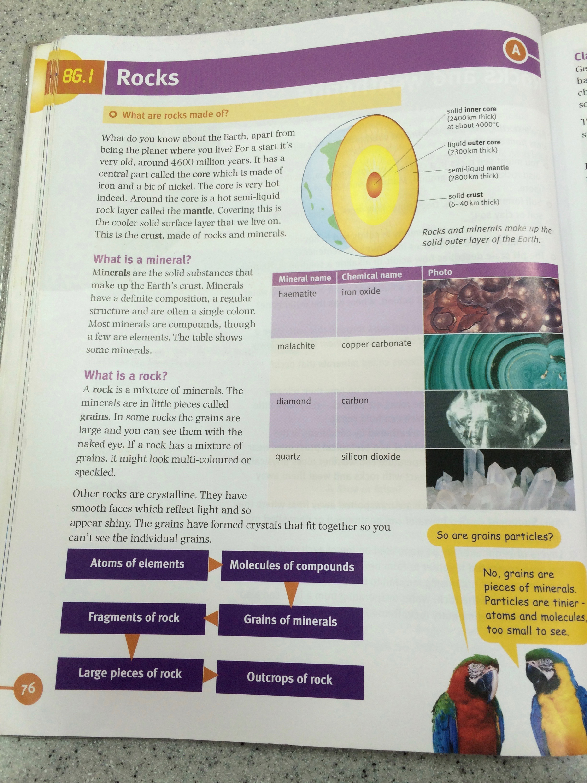
Textbook Page ref: Framework Science 8 8g.1 P76-77

