Slide 1
Combustion Practical 1
CWK
To plan an investigation into the effect of volume of air on the time it takes for a candle to go out.
To carry out an investigation
Lesson 22
MrMortonScience

Slide 2
An investigation into how the volume of a beaker will affect the time it takes for a candle to extinguish

Slide 4
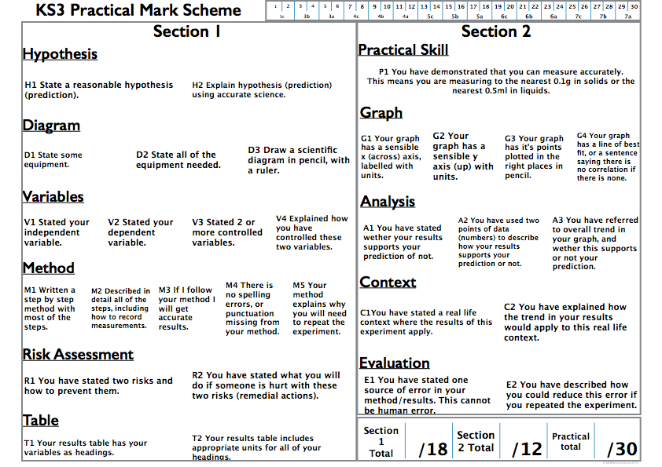

Slide 6
Your hypothesis must refer to both your independent variable and you dependent variable.
Use words like increase/decrease NOT change.

Slide 13
2 risks needed for R1, you can do all this in a table e.g..
RISK | Prevention | Remedial Action

Slide 15
Tables must be complete for T1

Slide 16
