Slide 1
Carbon Monoxide
CWK
CWK
State the adverse effect of Carbon Monoxide on health and discuss why this pollutant is of global concern.
Explain why carbon monoxide detectors are used.
Lesson 26
MrMortonScience

Slide 2
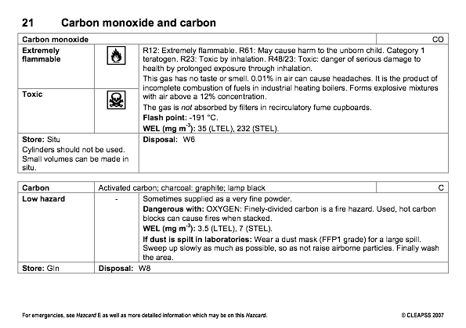

Slide 3
What does the hazcard tell you?
What do we need to watch out for in the lab?

Slide 4
Carbon Monoxide
Carbon monoxide is a poisonous gas.
It is formed during incomplete combustion.
TASK
The following slides give you information about CO, use this to answer the literacy exercise that follows.

Slide 5
When natural gas or other hydrocarbon fuels are burned, the products are normally carbon dioxide (CO2) and water.
However, if gas fires or heaters do not get enough oxygen, carbon monoxide (CO), soot (carbon) and water can be produced instead.
This can happen if the heater is not installed or maintained properly. Carbon monoxide is a poisonous gas, and kills around 30 people every year in the UK.
It is particularly dangerous because you cannot see it, smell it or taste it.

Slide 6
All the cells in your body need oxygen. It is carried in the blood by a substance called haemoglobin (pronounced ‘hee-mo-glow-bin’), which is found in the red blood cells. If you breathe in carbon monoxide it combines with the haemoglobin to form a compound called carboxyhaemoglobin.
Carboxyhaemoglobin cannot carry oxygen around your body. The more carbon monoxide you breathe, the less oxygen can get around your body, and eventually you suffocate.
Once carbon monoxide has combined with haemoglobin, it takes a long time for the chemical to return to normal. After you stop breathing in carbon monoxide, it will take 5 hours for the amount of carboxyhaemoglobin to halve.

Slide 7
The symptoms of carbon monoxide poisoning are headaches, fatigue, nausea and dizziness, which get worse as you breathe more of the gas.
If you are exposed to the gas for a long time (or too high concentrations of the gas) you could lose consciousness and die.

Slide 8
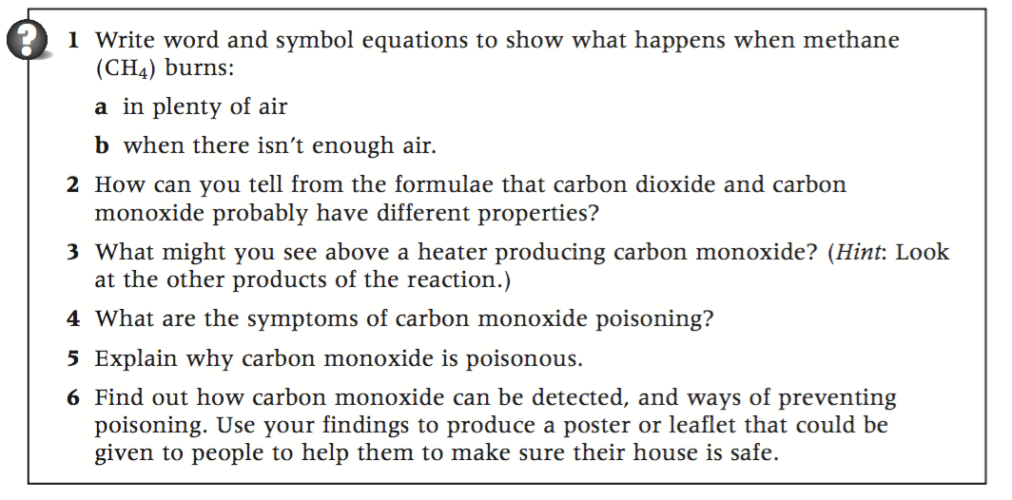

Slide 9
Combustion Equation for methane in plenty of air
1. Word equation with state symbols
methane(g) + oxygen(g) —> carbon dioxide(g) + water(g)
2. Replace words with symbols
CH4(g) + O2(g) —> CO2(g)+ H2O
2. Draw the particle diagrams
H
H
O
C
O
O
C
O
O
+
H2(g) + ) —> H2O(g)
H
H
H
H

Slide 10
2. Replace words with symbols
2. Draw the particle diagrams
Combustion Equation for methane in plenty of air
methane(g) + oxygen(g) —> carbon dioxide(g) + water(g)
CH4(g) + O2(g) —> CO2(g)+ H2O
4. Balance the particle diagram first
H
H
O
C
O
O
C
O
O
+
H2(g) + ) —> H2O(g)
H
H
H
H
The reactants have 4 hydrogen atoms
But the products only have 2 hydrogen atoms.

Slide 11
2. Replace words with symbols
2. Draw the particle diagrams
Combustion Equation for methane in plenty of air
methane(g) + oxygen(g) —> carbon dioxide(g) + water(g)
CH4(g) + O2(g) —> CO2(g)+ H2O
4. Balance the particle diagram first
H
H
O
C
O
O
C
O
O
+
H2(g) + ) —> H2O(g)
H
H
H
H
O
O
O
The products now have 4 hydrogen atoms
We add oxygen to balance the reactants
All balanced!
H
H

Slide 12
2. Replace words with symbols
2. Draw the particle diagrams
Combustion Equation for methane in plenty of air
methane(g) + oxygen(g) —> carbon dioxide(g) + water(g)
CH4(g) + 2O2(g) —> CO2(g)+ 2H2O
4. Balance the particle diagram first
H
H
O
C
O
O
O
O
H2(g) + ) —> H2O(g)
C
+
H
H
H
H
O
O
O
H
H
5. Balance the symbol equationn to match

Slide 13
2. Replace words with symbols
2. Draw the particle diagrams
Combustion Equation for methane in plenty of air
methane(g) + oxygen(g) —> carbon dioxide(g) + water(g)
CH4(g) + 2O2(g) —> CO2(g)+ 2H2O
4. Balance the particle diagram first
H
H
O
C
O
O
C
O
O
+
H2(g) + ) —> H2O(g)
H
H
H
H
O
O
O
H
H
5. Balance the symbol equationn to match

Slide 14
Combustion Equation for methane without enough air
1. Word equation with state symbols
methane(g) + oxygen(g) —> carbon monoxide(g) + water(g)
2. Replace words with symbols
CH4(g) + O2(g) —> CO(g)+ H2O
2. Draw the particle diagrams
H
H
O
C
O
O
C
O
+
H2(g) + ) —> H2O(g)
H
H
H
H

Slide 15
2. Replace words with symbols
2. Draw the particle diagrams
Combustion Equation for methane without enough air
methane(g) + oxygen(g) —> carbon monoxide(g) + water(g)
CH4(g) + O2(g) —> CO(g)+ H2O
4. Balance the particle diagram first
H
H
C
O
O
C
O
O
+
H2(g) + ) —> H2O(g)
H
H
H
H
The reactants have 4 hydrogen atoms
But the products only have 2 hydrogen atoms.

Slide 16
2. Replace words with symbols
2. Draw the particle diagrams
Combustion Equation for methane without enough air
methane(g) + oxygen(g) —> carbon monoxide(g) + water(g)
CH4(g) + O2(g) —> CO(g)+ H2O
4. Balance the particle diagram first
H
H
C
O
O
C
O
O
+
H2(g) + ) —> H2O(g)
H
H
H
H
O
The products now have 4 hydrogen atoms
Now we have the problem of uneven oxygen atoms.
O
So we multiply the whole equation by 2 so we can add O2 instead
H
H
We cannot add just O though, we need to add O2

Slide 17
2. Replace words with symbols
2. Draw the particle diagrams
Combustion Equation for methane without enough air
methane(g) + oxygen(g) —> carbon monoxide(g) + water(g)
CH4(g) + O2(g) —> CO(g)+ H2O
O
4. Balance the particle diagram first
H
H
H
H
C
O
O
C
O
O
+
H2(g) + ) —> H2O(g)
H
H
H
H
O
H
H
C
O
C
O
O
+
H2(g) + ) —> H2O(g)
H
H
H
H
O
O
All balanced!
O
H
H

Slide 18
2. Replace words with symbols
2. Draw the particle diagrams
Combustion Equation for methane without enough air
methane(g) + oxygen(g) —> carbon monoxide(g) + water(g)
2CH4(g) + O2(g) —> CO(g)+ H2O
O
4. Balance the particle diagram first
H
H
H
H
C
O
O
C
O
O
+
H2(g) + ) —> H2O(g)
H
H
H
H
O
H
H
C
O
C
O
O
+
H2(g) + ) —> H2O(g)
H
H
H
H
O
O
O
H
H

Slide 19
2. Replace words with symbols
2. Draw the particle diagrams
Combustion Equation for methane without enough air
methane(g) + oxygen(g) —> carbon monoxide(g) + water(g)
2CH4(g) + 3O2(g) —> CO(g)+ H2O
O
4. Balance the particle diagram first
H
H
H
H
C
O
O
C
O
O
+
H2(g) + ) —> H2O(g)
H
H
H
H
O
H
H
C
O
C
O
O
+
H2(g) + ) —> H2O(g)
H
H
H
H
O
O
O
H
H

Slide 20
2. Replace words with symbols
2. Draw the particle diagrams
Combustion Equation for methane without enough air
methane(g) + oxygen(g) —> carbon monoxide(g) + water(g)
2CH4(g) + 3O2(g) —> 2CO(g)+ H2O
O
4. Balance the particle diagram first
H
H
H
H
C
O
O
C
O
O
+
H2(g) + ) —> H2O(g)
H
H
H
H
O
H
H
C
O
C
O
O
+
H2(g) + ) —> H2O(g)
H
H
H
H
O
O
O
H
H

Slide 21
2. Replace words with symbols
2. Draw the particle diagrams
Combustion Equation for methane without enough air
methane(g) + oxygen(g) —> carbon monoxide(g) + water(g)
2CH4(g) + 3O2(g) —> 2CO(g)+ H2O
O
4. Balance the particle diagram first
H
H
H
H
C
O
O
C
O
O
+
H2(g) + ) —> H2O(g)
H
H
H
H
O
H
H
C
O
C
O
O
+
H2(g) + ) —> H2O(g)
H
H
H
H
O
O
O
H
H

Slide 22
Task 6
You are a reporter for the magazine “Living in a Scientific World”
Your job is to investigate whether carbon monoxide really is a killer and what can be done to stop this deadly killer.

Slide 23
Task 6
The findings of the investigation should be written up for the magazine.
The editor will only allow two sides of A4, and expects it to be clearly illustrated with pictures, diagrams and maybe even charts and tables.

Slide 24
Your article…
Your article should include the following:
Physical properties of carbon monoxide that makes it a silent killer
Sources of carbon monoxide and the risk it poses in the home
The symptoms and science of carbon monoxide poisoning
Methods of detecting and alerting people to the presence of carbon monoxide
Recommendations for protecting your family from carbon monoxide poisoning

