Slide 1
Global Dimming
State the adverse effect of Global Dimming and discuss why these pollutants are of global concern
Relate this to particle theory and light diffraction/reflection.
Lesson 27
MrMortonScience

Slide 2
Advanced Symbols Equation
We have learned to use symbol equations to represent the chemicals in a reaction.
We have learned to use the particle diagrams to help us balance these symbol equations.
This means we have the same atoms on both side of the equation without changing any of the molecules, but just by adding more of the same molecules to each side until the reaction is balanced.

Slide 3
Advanced Symbols Equation
In real life reactions thousands of molecules are reacting at a time. This means that our symbol don't represent individual molecules any more but thousands of them.
In this way our symbol equation represents the proportions between the atoms, or the ratio.

Slide 4
Advanced Symbols Equation
methane(g) + oxygen(g) —> carbon dioxide(g) + water(g)
CH4(g) + 2O2(g) —> CO2(g)+ 2H2O
1 : 2 : 1: 2
In this way after we have balanced an equation we know the ratios of the reactants and products.
eg. 1000 molecules of methane will always combust to produce 2000 molecules of water and 1000 molecules of carbon dioxide.

Slide 5
Incomplete combustion
It is very rare that a flame will get all the oxygen it needs to combust a fuel completely. Many fuels are more complicated than methane and can have many atoms of hydrogen and carbon in them.
No matter what all the hydrogen is turned into water, but if there isn't enough oxygen not all of the carbon atoms will form carbon dioxide or even carbon monoxide, some of the carbon atoms will just turn back to carbon.
We call this carbon soot.

Slide 6
Soot
Soot in the air is called smoke, whenever you see a flame producing smoke it is producing carbon atoms.
Another way we can tell if a flame is producing soot is if it is yellow, when you heat carbon atoms to a high temperature they give off a yellow light - this is why most flames are yellow.
!If a flame is producing carbon (ie yellow) it is probably producing carbon monoxide as well, make sure the area is ventilated.

Slide 7
methane(g) + oxygen(g) —> carbon(s) + water(g)
CH4(g) + O2(g) —> C(s)+ 2H2O
What is the ratio of the reactants and products?

Slide 8
Explosions
Explosions occur in a chemical reaction when the ratio of gas products is much higher than the ratio of gas reactants.
This is because gasses take up a lot of space and if the space isn’t available they explode.
petrol(g) + oxygen(g) —> carbon dioxide(g) + water(g)
C9H18(l) + 14O2(g) —> 9CO2(g)+ 10H2O
1 : 14 : 9: 10
Petrol can be explosive because the ratio of gas reactants to products is 14:19
Actual explosives often use oxygen in the form of a solid to make this ratio even faster.

Slide 9
What are the problems with soot or smoke?
Think Pair share

Slide 10
What are the problems with soot or smoke?
People with asthma
Makes buildings dirty
Smog
Blocks out sunlight
Less photosynthesis
Plants cant grow as much food
Less food to feed people

Slide 11
In the last few years, some scientists have been measuring how much sunlight is reaching the surface of the Earth and comparing it to records from the last 50 years.
They have been amazed to find that in some areas nearly 25% less sunlight has been reaching the surface compared to 50 years ago.
They have called this global dimming.

Slide 12
They think that it is caused by particles of soot and ash that are produced when fossil fuels are burnt.
These particles reflect sunlight back into space, or they can help to produce more clouds that reflect the sunlight back into space.
However, there are many scientists who don't believe the change is real and blame it on inaccurate recording equipment.

Slide 13
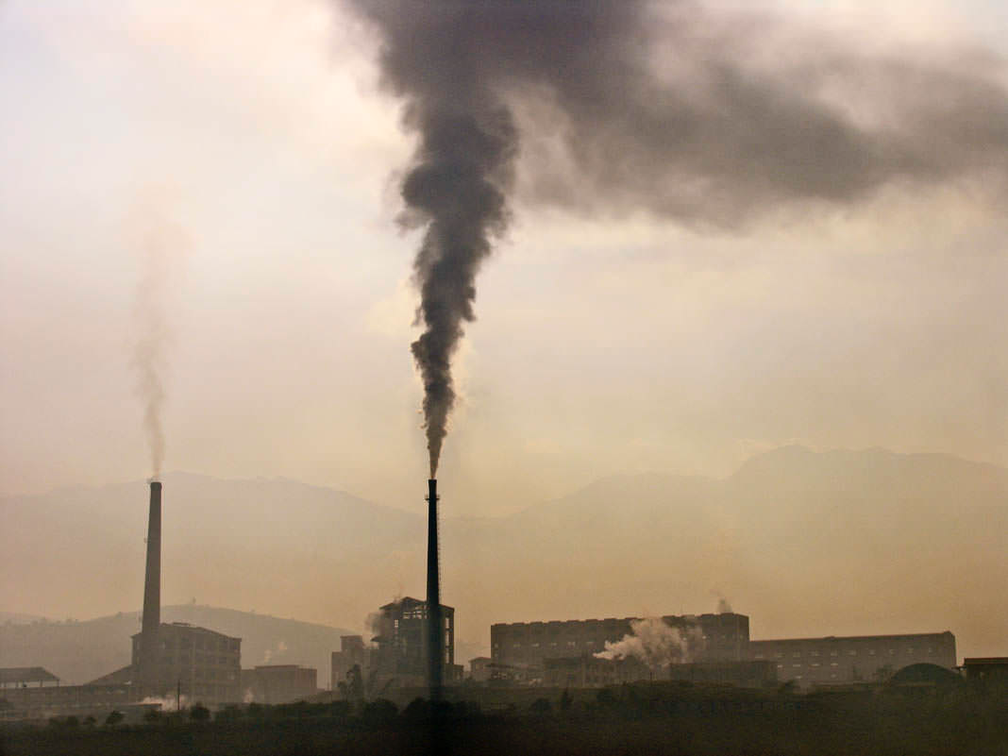
Thick black smoke being released into the air. The particulate carbon in this smoke could contribute to global dimming.

Slide 14
Sunlight is absorbed and
reflected by soot particles

Slide 15
BUT THIS IS WHY DOHA GETS
AWESOME SUNSETS AND SUNRISES

