Slide 1
Earthquakes
CWK
CWK
State that earthquakes are most frequent at tectonic plate boundaries.
Explain what causes earthquakes suddenly.
Explain why people might not evacuate overtime there is an earthquake warning.
Lesson 3
MrMortonScience

Slide 2
Earthquakes
cwk
date
Starter: Think Pair Share
Are all earthquakes the same?
Which Earthquakes are more dangerous?
Do they occur everywhere?

Slide 3
Earthquakes
cwk
date
We have millions of Earthquakes around the world every year but most are not even felt by people.
We use sensitive equipment called seismometers which produce seismographs to detect these Earthquakes.

Slide 4
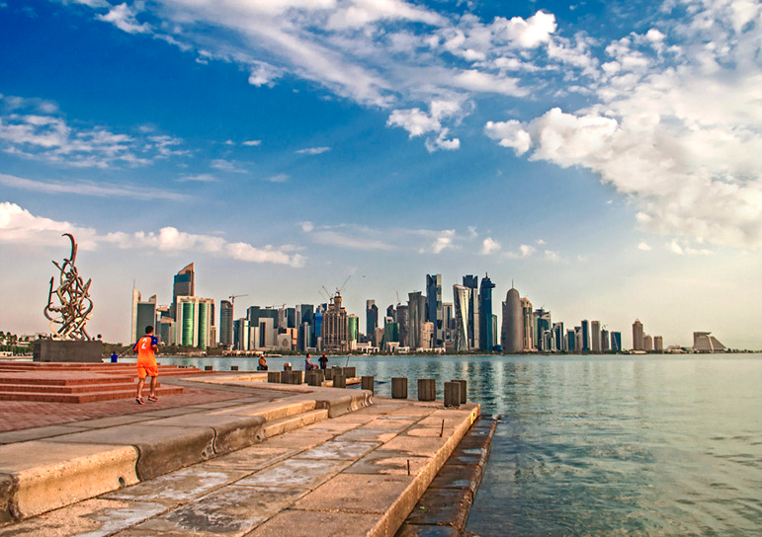
Tremors from 7.5 magnitude earthquake in Afghanistan felt in Qatar
By: SHABINA S. KHATRI | October 26, 2015
View as "Clean Read"
Residents from across Qatar have reported feeling the aftershocks of a powerful earthquake that originated in Afghanistan this afternoon.
According to tweets, the tremors were felt in West Bay, Al Sadd, old Airport and other parts of the country shortly before 12:30pm.

Slide 5
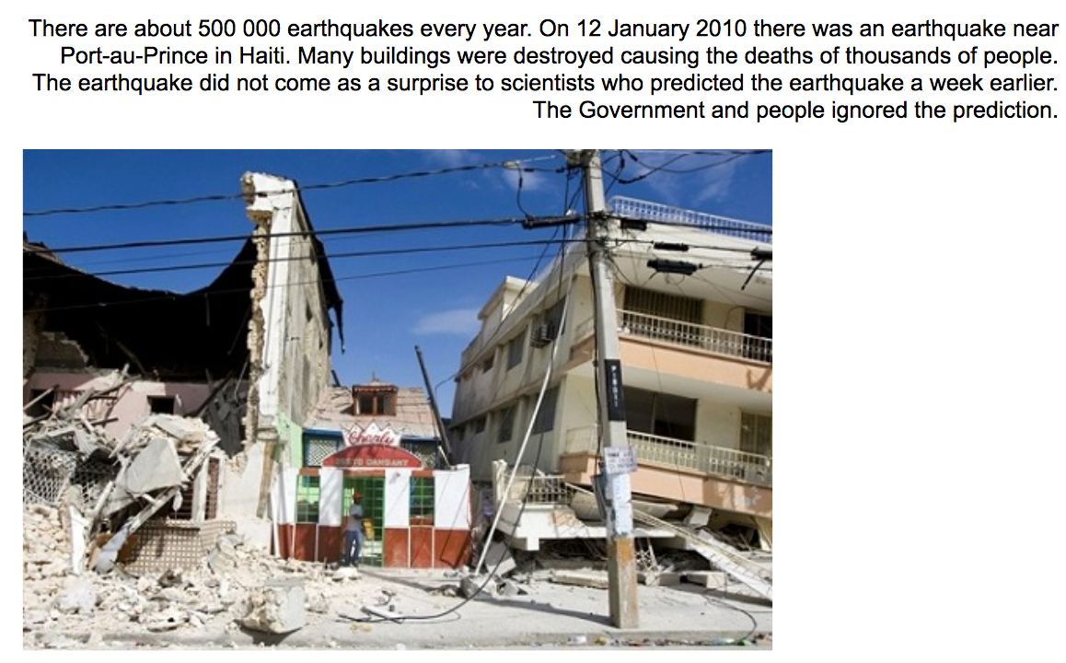

Slide 6
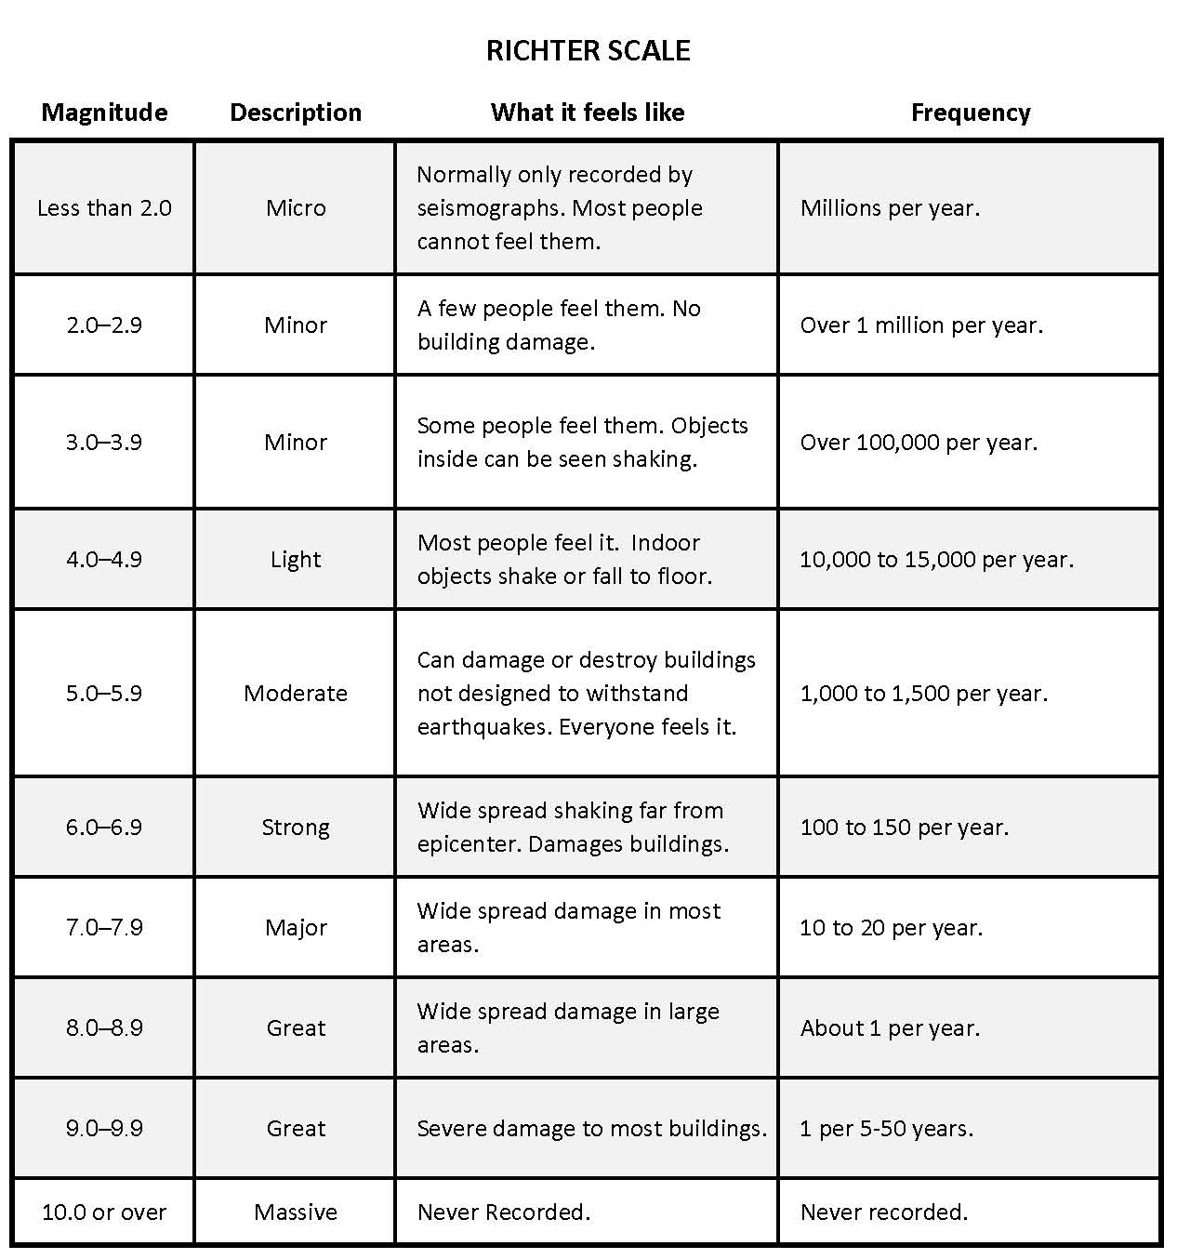
The Richter scale

Slide 7
Earthquakes
cwk
date
Do they occur everywhere?

Slide 8
Earthquakes
cwk
date
They occur on tectonic plate boundaries.

Slide 9
Earthquakes
cwk
date
They occur on tectonic plate boundaries.

Slide 10
Earthquakes
CWK
CWK
State that earthquakes are most frequent at tectonic plate boundaries.
Explain what causes earthquakes suddenly.
Explain why people might not evacuate overtime there is an earthquake warning.
Lesson 3
MrMortonScience

Slide 11
Earthquakes
cwk
date
Why might Earthquakes be difficult to predict?

Slide 12
Earthquakes
cwk
date
Why might Earthquakes be difficult to predict?
Earthquakes are caused by sudden movements of the Earths tectonic plates.
Tectonic plates are moving but friction stops them from moving all the time so pressure builds up until the force is bigger than the friction and then they move suddenly.
This is what causes an earthquake. Tectonic plates might not move at all for years then move a few meters in a few seconds.

Slide 13
Earthquakes
cwk
date
Why might Earthquakes be difficult to predict?
Earthquakes are caused by sudden movements of the Earths tectonic plates.
Tectonic plates are moving but friction stops them from moving all the time so pressure builds up until the force is bigger than the friction and then they move suddenly.
This is what causes an earthquake. Tectonic plates might not move at all for years then move a few meters in a few seconds.

Slide 14
Earthquakes
CWK
CWK
State that earthquakes are most frequent at tectonic plate boundaries.
Explain what causes earthquakes suddenly.
Explain why people might not evacuate overtime there is an earthquake warning.
Lesson 3
MrMortonScience

Slide 15
Earthquakes
cwk
date
Why are the effects of the Earthquake on people who live there?

Slide 20
Earthquakes
cwk
date
If earthquakes are so destructive why don’t people evacuate everyone there is a mild tremor?

Slide 21
Earthquakes
Scientists can use these clues to predict that an earthquake will happen, but these predictions are sometimes ignored by local people and governments. Here are the reasons why.
▪ Even with all their clues scientists can only say that an earthquake's likely to happen, not that it definitely will happen. Scientists make many earthquake predictions every year and not all of them are right.
▪ If the earthquake does happen, it's impossible to predict exactly when. The earthquake could happen months after the initial prediction.
▪ There's no way to accurately predict the strength of the earthquake. Many earthquakes cause little or no damage.
▪ Scientists can't accurately predict exactly where the earthquake will happen — it could be miles away from where it was initially predicted to happen.
▪ There's no way to stop an earthquake, so the only way that people can respond to a predicted earthquake is to evacuate. This is expensive and very inconvenient, so people don't want to evacuate unless they are sure that the earthquake will happen imminently, will happen where they live and will be strong enough to cause some serious damage and put their lives at risk.

Slide 22
Earthquakes
cwk
date
Scientists don’t know exactly where earthquakes are going to happen.
Scientists don’t know exactly when earthquakes are going to happen.
Scientists don’t know how strong earthquakes are going to be.
Evacuation is very expensive.

Slide 23
Earthquakes
CWK
CWK
State that earthquakes are most frequent at tectonic plate boundaries.
Explain what causes earthquakes suddenly.
Explain why people might not evacuate overtime there is an earthquake warning.
Lesson 3
MrMortonScience

