Slide 1
Suitability of Metals
CWK
Date
Explain why aluminium is used to make aircraft bodies and food containers
Understand the difference between a metal and an alloy
Analyse why different steel alloys are used for specific jobs
Lesson 3
MrMortonScience

Slide 2
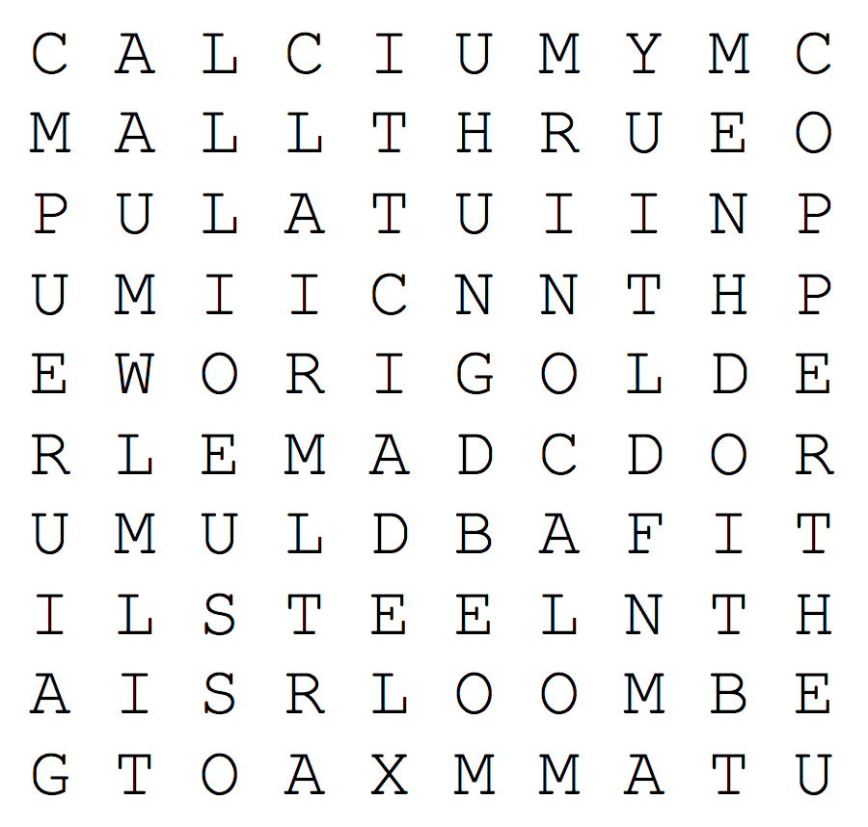
Suitability of metals
cwk
date
Task - Find the metals

Slide 3
Suitability of metals
cwk
date
Task - Match the metal to it’s use
Making jewellery.
Electrical cables.
Compounds of this metal are essential for healthy bones and teeth.
Making aeroplanes.
Making buildings.
This is a liquid metal found in thermometers.
Compounds of this metal are used in hospital scans to help show digestive systems clearly on an X-ray.
Fishing weights.

Slide 4
Suitability of metals
cwk
date
Element, compound, mixture, Alloy?
How would you define these?

Slide 5
Suitability of metals
cwk
date
Alloys

Slide 6
Suitability of metals
cwk
date
Types of Steel

Slide 7
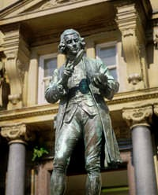
Suitability of metals
cwk
date
Here are some examples of common alloys:
Bronze
Bronze is an alloy of copper and tin. It's harder than copper and it's good for making medals and statues from.
Each side column item (e.g. an image, a tip, a video link) goes in its own sidebox construct Button to be shown when the side column is hidden go outside of the shift div
Cupronickel
Cupronickel is an alloy of copper and nickel. It's hard and corrosion-resistant. It's used to make “silver” coins.
Gold alloys
Gold alloys are used to make jewellery as pure gold is too soft. Metals such as zinc, copper, silver, palladium and nickel are used to harden the “gold”.
Aluminium alloys
Aluminium alloys are used to make aircraft. Aluminium has a low density,
but it's alloyed with small amounts of other metals to make it stronger.

Slide 8
You are a metal merchant, you have new stock of the following metals and you need to sell as much as you can to your customers.
Find out what the advantages of each metal are. Use this information to prepare an argument for why each customer should buy your metal.
Suitability of metals
cwk
date
Task - Metal Merchant

Slide 9
1. Aluminium-Titanium Alloy
2. Low Purity copper, with a tarnish proof coating.
3. High Carbon steel
Suitability of metals
cwk
date
Task - Metal Merchant
A. SWITCH A pen knife manufacturer. Who is known for their reliable grades.
B. CIRCULATORY SYSTEMS A plumbing company who installs water pipes in houses.
C. Qatar Airways looking to build a new high speed aircraft.
D. SpeedWire - a broadband company needing new electrical cables.

