Slide 1
4 - Bending light, Refraction
cwk
Date
Level 4 - 1. Describe how light is refracted at plane surfaces
Level 5 - Describe how light bends towards the normal (inwards) when travelling from a less dense to a more dense medium, and vice versa
Level 6 - Make predictions about image formation using the patterns of behaviour from refraction
Qatar International School Science Department

Slide 2
Bell Task
Refraction is the bending of light.
When do you see this in real life?
CLUE: Whenever you see light come though something transparent but it isn't exactly what is on the other side you are probably seeing refraction.

Slide 3
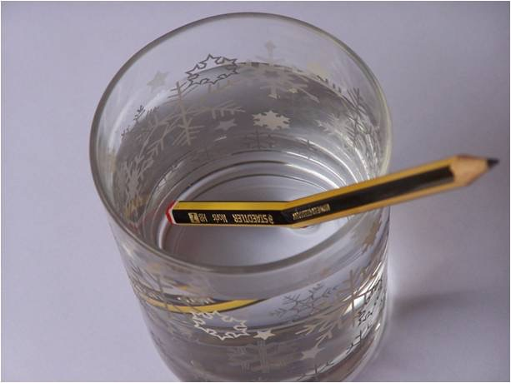
Starter
Why does the pencil appear bent in the water?

Slide 4
Starter
The pencil appears bent because light travels at different speeds in different materials.
This causes the light to bend/refract.
Refraction is the change in the direction of light.

Slide 5
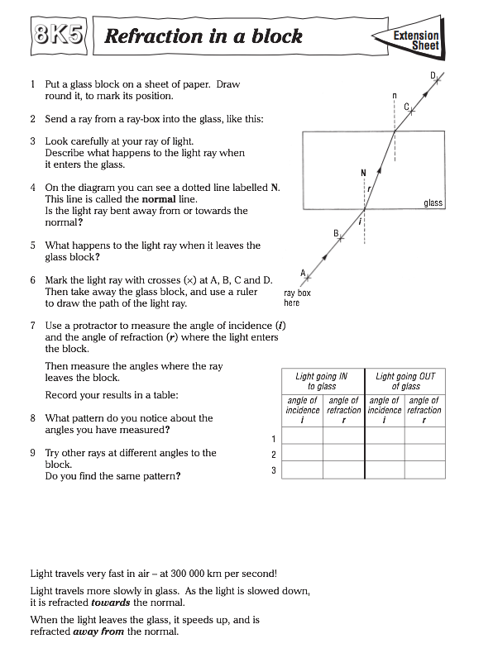

Slide 7
Main - How to draw refraction diagrams
Draw around your glass/perspex block in the middle of your page.

Slide 8
Main - How to draw refraction diagrams
Choose where you will shine your ray of light and draw on your normal.
normal

Slide 9
Main - How to draw refraction diagrams
Draw your incident ray with a ruler and pencil.
incident ray
normal

Slide 10
Main - How to draw refraction diagrams
Shine the laser/ray though the block and mark where it emerges and one other point on the ray
incident ray
normal
x
x

Slide 11
Main - How to draw refraction diagrams
incident ray
normal
x
Then move the block away and join up your points to show the emerging ray
x

Slide 12
Main - How to draw refraction diagrams
incident ray
normal
x
You can then work out the path through the block that the light must have taken and join up your first two lines
Then draw a normal where the line leaves the block.
x

Slide 13
Main - Law of Refraction
We can predict which way light will refract.
AIR
When light moves from a less dense medium to a more dense medium it bends towards the normal. Like here
This happens because the air is less dense than the glass.
GLASS
x
x

Slide 14
Main - Law of Refraction
We can predict which way light will refract.
When light moves from a MORE dense medium to a LESS dense medium it bends away from the normal. Like here
This happens because the air is less dense than the glass.
GLASS
x
AIR
x

Slide 15
Main - Law of Refraction
Here the red line represents where the light would go if the glass wasn’t there.
Refraction means the ray bends towards the normal in the block so the orange ray is closer to the normal than the red.
AIR
GLASS
x
x

Slide 16
Plenary
Many visual effects are caused by refraction.
This ruler appears bent because the light from one end of the ruler has been diffracted, but light from the other end has travelled in a straight line.
Would the ruler appear more or less bent if the water was replaced with glass?

Slide 17
Plenary
Many visual effects are caused by refraction.
This ruler appears bent because the light from one end of the ruler has been diffracted, but light from the other end has travelled in a straight line.
Would the ruler appear more or less bent if the water was replaced with glass?
More bent, because glass is more dense than water.

Slide 18
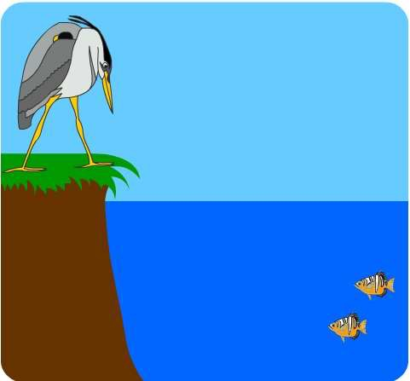
Extension Questions
Fishing animals have to be aware of refraction because the image of the fish is not actually where the fish is.
Add rays to this diagram to show how the image of the fish appears above the real fish.
image
actual location

Slide 19
Extension Questions
image
actual location

Slide 20
Answer A, B, C or D
Refraction is what happens when light:
A hits an opaque object
B bounces off a mirror
C is scattered unevenly by a rough surface
D changes direction as it goes from one substance into another

Slide 21
Answer A, B, C or D
2) Refraction occurs because:
A light speeds up when it goes from air to glass or water
B light slows down when it goes from air to glass or water
C light stops when it goes from air to glass or water
D light reflects inside transparent materials

Slide 22
Answer A, B, C or D
3) Why does a lens change the path of light?
A Light changes direction when it goes into the glass and when it comes out of it
B Light changes direction in the centre of the lens
C Light is reflected by the surface of the lens
D Light travels faster in glass than it does in air

Slide 23
4 - Bending light, Refraction
cwk
Date
Level 4 - 1. Describe how light is refracted at plane surfaces
Level 5 - Describe how light bends towards the normal (inwards) when travelling from a less dense to a more dense medium, and vice versa
Level 6 - Make predictions about image formation using the patterns of behaviour from refraction
Which level do you think you achieved today?
Qatar International School Science Department

