Slide 1
Methods for Making Salts
CWK
Date
Outline the methods used to prepare metal salts
Investigate how to make copper sulphate salt
Lesson 4
MrMortonScience

Slide 2
Roger Hiorns – Chemical artist
Roger Hiorns is a famous British artist who create a beautiful piece of artistic work–
https://vimeo.com/68176170
“Destined to be remembered as one of the truly worthwhile and significant moments of modern British art” (Jonathan Jones, The Guardian), 151-189 Harper Road, near Elephant & Castle became a site of pilgrimage, with hundreds of people making their way across the capital to the anonymous council flat each day. The exhibit closed to the public in January 2010.

Slide 3
Roger Hiorns – Chemical artist
What do you think the blue crystals are?
How did he manage to make such a beautiful artistic creation from a disused apartment in London?

Slide 4
MAKING SALTS BY FILTRATION AND EVAPORATION NEUTRALISING METAL COMPOUNDS THAT CANNOT DISSOLVE IN WATER WITH ACIDS
Notes:
Teacher notes
This four-stage animation shows how a salt is obtained from copper oxide powder.

Slide 5
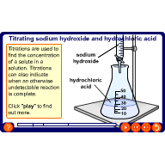
MAKING SALTS BY TITRATION NEUTRALISING ACIDS AND BASES DISSOLVED IN WATER
Notes:
Teacher notes
This four-stage animation shows how titration is used to find the concentration of a solute in a solution.

Slide 6
MAKING SALTS BY PRECIPITATION REACTING TO SALTS TO FORM A NEW SALT
Sometimes when two solutions are mixed, they react to form an insoluble solid product.
The insoluble solid product is called a precipitate.
You can spot a precipitate because the mixture goes cloudy.
For example, mixing solutions of lead nitrate and sodium chloride produces a yellow precipitate of lead chloride.
lead
nitrate
+
sodium
chloride
lead
chloride
+
sodium
nitrate
➔
Pb(NO₃)₂ (aq)
+
2NaCl (aq)
➔
PbCl₂ (s)
+
2NaNO₃ (aq)

Slide 7
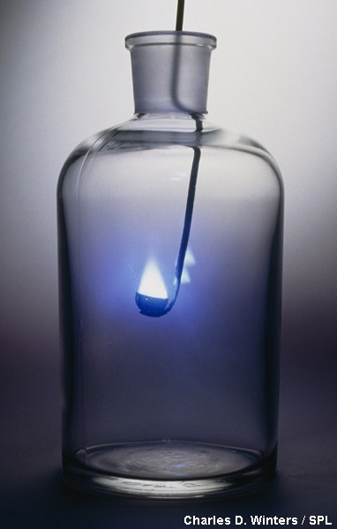
MAKING SALT BY DIRECT REACTION OF ELEMENTS
REACTING BASIC AND ACIDIC ELEMENTS.
For example, when a piece of sodium reacts with chlorine gas it produces the white solid sodium chloride
The word equation for this reaction is:
+
sodium
chloride
sodium
chlorine
➔
2Na(s)
+
Cl₂(g)
➔
2NaCl(s)

Slide 8
How its made copper
https://www.youtube.com/watch?v=89r8fIR34Gc

