Slide 1
Properties of metals
lustrous (shiny)
malleable (bendy/pressed into shapes)
mirror/jewellery
coins/utensils
good conductor of e-
wires
Physical Properties of Metals
high strength
high density
buildings
eg anchor
good conductor of heat
saucepans, radiators
ductile (stretched into wires)
sonorous - vibrates easily
electricity cables
tuba, french horn

Slide 2
Structure of Metals
Why are metals malleable?
The atoms in a metal are arranged in a regular pattern.
The atoms are in layers.
Layers can slide over each other.

Slide 3
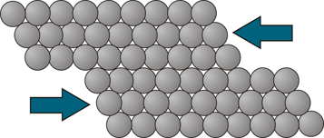
Structure of Metals
Why are metals malleable?
The atoms in a metal are arranged in a regular pattern.
The atoms are in layers.
Layers can slide over each other.

Slide 4
Structure of Metals
Why do metals have a high boiling point?
In metals, the electrons in the outer shells of the atoms are delocalised.
There are strong forces of electrostatic attraction between the positive metal ions and the negative electrons.
These strong forces hold the metal structure together.

Slide 5
Structure of Metals
Why do metals have a high electrical conductivity?
In metals, the electrons in the outer shells of the atoms are delocalised.
They’re free to move through the whole structure
They carry the electric current (or heat energy).

