Slide 1
Welcome to IGCSE Chemistry
Cambridge IGCSE Chemistry
The syllabus can be found on the link below:
http://www.cie.org.uk/images/167037-2016-2018-syllabus.pdf

Slide 2
Structure of the course
End of course examinations during summer 2017
3 examinations:
Paper 1 or 2: Multiple choice, 45 minutes, 30% of total mark (Most pupils at QIS do the higher paper)
Paper 3 or 4: short answer and structured questions, 75 minutes, 50% of total mark (Most pupils at QIS do the higher paper)
Paper 6: Alternative to Practical Exam, 60 minutes, 20% of total mark

Slide 3
Topics studies in year 10
Experimental techniques
Atoms and particles
Periodic table
Chemical changes and reactions
Acids and bases
Carbonates, air water and sulphur
End of year examination in the summer term of 2016

Slide 4
Structure
During each unit:
IDEAL task – formative task that will be completed in lesson and you will be given a grade and detailed feedback on. (like the badger tasks you do now)
Following each unit:
End of unit assessment, mixture of multiple choice and structured answer question. You will be given a percentage and a grade.

Slide 5
Homework
You will likely have 2 teachers for iGCSE chemistry
You will be expected to complete weekly homework tasks for both of your teachers.

Slide 6
iGCSE Chemistry Specification
2016-2018
(c) MRMORTONSCIENCE 2015

Slide 7
1. The particulate nature of matter

Slide 8
1. The particulate nature of matter
State the distinguishing properties of solids, liquids and gases
Describe the structure of solids, liquids and gases in terms of particle separation, arrangement and types of motion
Describe changes of state in terms of melting, boiling, evaporation, freezing, condensation and sublimation
Explain changes of state in terms of the kinetic theory
Describe qualitatively the pressure and temperature of a gas in terms of the motion of its particles

Slide 9
1. The particulate nature of matter
Show an understanding of the random motion of particles in a suspension (sometimes known as Brownian motion) as evidence for the kinetic particle (atoms, molecules or ions) model of matter
Describe and explain diffusion
Describe and explain Brownian motion in terms of random molecular bombardment
State evidence for Brownian motion
Describe and explain dependence of rate of diffusion on molecular mass

Slide 10
2. Experimental techniques

Slide 11
2.1 Measurement
Name appropriate apparatus for the measurement of time, temperature, mass and volume, including burettes, pipettes and measuring cylinders

Slide 12
2.2.1 Criteria of purity
Demonstrate knowledge and understanding of paper chromatography
Interpret simple chromatograms, including the use of R_{f} values
Identify substances and assess their purity from melting point and boiling point information
Understand the importance of purity in substances in everyday life, e.g. foodstuffs and drugs
Outline how chromatography techniques can be applied to colourless substances by exposing chromatograms to substances called locating agents

Slide 13
2.2.2 Methods of purification
Describe and explain methods of purification by the use of a suitable solvent, filtration, crystallisation and distillation (including use of fractionating column).
(Refer to the fractional distillation of petroleum in section 14.2 and products of fermentation in section 14.6.)
Suggest suitable purification techniques, given information about the substances involved

Slide 14
3. Atoms, elements and compounds

Slide 15
3.1 Atomic structure and the Periodic Table
State the relative charges and approximate relative masses of protons, neutrons and electrons
Define proton number (atomic number) as the number of protons in the nucleus of an atom
Define nucleon number (mass number) as the total number of protons and neutrons in the nucleus of an atom
Use proton number and the simple structure of atoms to explain the basis of the Periodic Table (see section 9), with special reference to the elements of proton number 1 to 20
Define isotopes as atoms of the same element which have the same proton number but a different nucleon number

Slide 16
3.1 Atomic structure and the Periodic Table
Understand that isotopes have the same properties because they have the same number of electrons in their outer shell
State the two types of isotopes as being radioactive and non-radioactive
State one medical and one industrial use of radioactive isotopes
Describe the build-up of electrons in ‘shells’ and understand the significance of the noble gas electronic structures and of the outer shell electrons (The ideas of the distribution of electrons in s and p orbitals and in d block elements are not required.)

Slide 17
3.2.1 Bonding: the structure of matter
Describe the differences between elements, mixtures and compounds, and between metals and non-metals
Describe an alloy, such as brass, as a mixture of a metal with other elements

Slide 18
3.2.2 Ions and ionic bonds
Describe the formation of ions by electron loss or gain
Describe the formation of ionic bonds between elements from Groups I and VII
Describe the formation of ionic bonds between metallic and non-metallic elements
Describe the lattice structure of ionic compounds as a regular arrangement of alternating positive and negative ions

Slide 19
3.2.3 Molecules and covalent bonds
Describe the formation of single covalent bonds in H2, Cl2, H2O, CH4, NH3 and HCl as the sharing of pairs of electrons leading to the noble gas configuration
Describe the differences in volatility, solubility and electrical conductivity between ionic and covalent compounds
Describe the electron arrangement in more complex covalent molecules such as N2, C2H4, CH3OH and CO2
Explain the differences in melting point and boiling point of ionic and covalent compounds in terms of attractive forces

Slide 20
3.2.4 Macromolecules
Describe the giant covalent structures of graphite and diamond
Relate their structures to their uses, e.g. graphite as a lubricant and a conductor, and diamond in cutting tools
Describe the macromolecular structure of silicon(IV) oxide (silicon dioxide)
Describe the similarity in properties between diamond and silicon(IV) oxide, related to their structures

Slide 21
3.2.5 Metallic bonding
Describe metallic bonding as a lattice of positive ions in a ‘sea of electrons’ and use this to describe the electrical conductivity and malleability of metals

Slide 22
4. Stoichiometry

Slide 23
4.1 Stoichiometry
Use the symbols of the elements and write the formulae of simple compounds
Deduce the formula of a simple compound from the relative numbers of atoms present
Deduce the formula of a simple compound from a model or a diagrammatic representation
Construct word equations and simple balanced chemical equations
Define relative atomic mass, Ar , as the average mass of naturally occurring atoms of an element on a scale where the 12C atom has a mass of exactly 12 units

Slide 24
4.1 Stoichiometry
Define relative molecular mass, Mr , as the sum of the relative atomic masses (Relative formula mass or Mr will be used for ionic compounds.) (Calculations involving reacting masses in simple proportions may be set. Calculations will not involve the mole concept.)
Determine the formula of an ionic compound from the charges on the ions present
Construct equations with state symbols, including ionic equations
Deduce the balanced equation for a chemical reaction, given relevant information

Slide 25
4.2 The mole concept
Define the mole and the Avogadro constant
Use the molar gas volume, taken as 24dm3 at room temperature and pressure
Calculate stoichiometric reacting masses, volumes of gases and solutions, and concentrations of solutions expressed in g/dm3 and mol/dm3 (Calculations involving the idea of limiting reactants may be set. Questions on the gas laws and the conversion of gaseous volumes to different temperatures and pressures will not be set.)
Calculate empirical formulae and molecular formulae
Calculate percentage yield and percentage purity

Slide 26
5. Electricity and chemistry

Slide 27
5. Electricity and chemistry
Define electrolysis as the breakdown of an ionic compound, molten or in aqueous solution, by the passage of electricity
Describe the electrode products and the observations made during the electrolysis of:
Relate the products of electrolysis to the electrolyte and electrodes used, exemplified by the specific examples in the Core together with aqueous copper(II) sulfate using carbon electrodes and using copper electrodes (as used in the refining of copper)
Describe electrolysis in terms of the ions present and reactions at the electrodes in the examples given
– molten lead(II) bromide – concentrated hydrochloric acid – concentrated aqueous sodium chloride – dilute sulfuric acid between inert electrodes (platinum or carbon)

Slide 28
5. Electricity and chemistry
State the general principle that metals or hydrogen are formed at the negative electrode (cathode), and that non-metals (other than hydrogen) are formed at the positive electrode (anode)
Predict the products of the electrolysis of a specified binary compound in the molten state
Describe the electroplating of metals
Outline the uses of electroplating
Describe the reasons for the use of copper and (steel- cored) aluminium in cables, and why plastics and ceramics are used as insulators

Slide 29
5. Electricity and chemistry
Predict the products of electrolysis of a specified halide in dilute or concentrated aqueous solution
Construct ionic half-equations for reactions at the cathode
Describe the transfer of charge during electrolysis to include:
– the movement of electrons in the metallic conductor
– the removal or addition of electrons from the external circuit at the electrodes
– the movement of ions in the electrolyte
Describe the production of electrical energy from simple cells, i.e. two electrodes in an electrolyte. (This should be linked with the reactivity series in section 10.2 and redox in section 7.4.)
Describe, in outline, the manufacture of:
– aluminium from pure aluminium oxide in molten cryolite (refer to section 10.3)
– chlorine, hydrogen and sodium hydroxide from concentrated aqueous sodium chloride (Starting materials and essential conditions should be given but not technical details or diagrams.)

Slide 30
6. Chemical energetics

Slide 31
6.1 Energetics of a reaction
Describe the meaning of exothermic and endothermic reactions
Interpret energy level diagrams showing exothermic and endothermic reactions
Describe bond breaking as an endothermic process and bond forming as an exothermic process
Draw and label energy level diagrams for exothermic and endothermic reactions using data provided
Calculate the energy of a reaction using bond energies

Slide 32
6.2 Energy transfer
Describe the release of heat energy by burning fuels
State the use of hydrogen as a fuel
Describe radioactive isotopes, such as 235U, as a source of energy
Describe the use of hydrogen as a fuel reacting with oxygen to generate electricity in a fuel cell (Details of the construction and operation of a fuel cell are not required.)

Slide 33
7. Chemical reactions

Slide 34
7.1 Physical and chemical changes
Identify physical and chemical changes, and understand the differences between them

Slide 35
7.2 Rate (speed) of reaction
Describe and explain the effect of concentration, particle size, catalysts (including enzymes) and temperature on the rate of reactions
Describe the application of the above factors to the danger of explosive combustion with fine powders (e.g. flour mills) and gases (e.g. methane in mines)
Demonstrate knowledge and understanding of a practical method for investigating the rate of a reaction involving gas evolution
Devise and evaluate a suitable method for investigating the effect of a given variable on the rate of a reaction
Interpret data obtained from experiments concerned with rate of reaction

Slide 36
7.2 Rate (speed) of reaction
Describe and explain the effects of temperature and concentration in terms of collisions between reacting particles (An increase in temperature causes an increase in collision rate and more of the colliding molecules have sufficient energy (activation energy) to react whereas an increase in concentration only causes an increase in collision rate.)
Describe and explain the role of light in photochemical reactions and the effect of light on the rate of these reactions (This should be linked to section 14.4.)
Describe the use of silver salts in photography as a process of reduction of silver ions to silver; and photosynthesis as the reaction between carbon dioxide and water in the presence of chlorophyll and sunlight (energy) to produce glucose and oxygen

Slide 37
7.4 Redox
Define oxidation and reduction in terms of oxygen loss/gain. (Oxidation state limited to its use to name ions, e.g. iron(II), iron(III), copper(II), manganate(VII).)
Define redox in terms of electron transfer
Identify redox reactions by changes in oxidation state and by the colour changes involved when using acidified potassium manganate(VII), and potassium iodide. (Recall of equations involving KMnO4 is not required.)
Define oxidising agent as a substance which oxidises another substance during a redox reaction. Define reducing agent as a substance which reduces another substance during a redox reaction.
Identify oxidising agents and reducing agents from simple equations

Slide 38
8. Acids, bases and salts

Slide 39
8.1 The characteristic properties of acids and bases
Describe the characteristic properties of acids as reactions with metals, bases, carbonates and effect on litmus and methyl orange
Describe the characteristic properties of bases as reactions with acids and with ammonium salts and effect on litmus and methyl orange
Describe neutrality and relative acidity and alkalinity in terms of pH measured using Universal Indicator paper (whole numbers only)
Describe and explain the importance of controlling acidity in soil

Slide 40
8.1 The characteristic properties of acids and bases
Define acids and bases in terms of proton transfer, limited to aqueous solutions
Describe the meaning of weak and strong acids and bases

Slide 41
8.2 Types of oxides
Classify oxides as either acidic or basic, related to metallic and non-metallic character
Further classify other oxides as neutral or amphoteric

Slide 42
8.3 Preparation of salts
Demonstrate knowledge and understanding of preparation, separation and purification of salts as examples of some of the techniques specified in section 2.2.2 and the reactions specified in section 8.1
Demonstrating knowledge and understanding of the preparation of insoluble salts by precipitation
Suggest a method of making a given salt from a suitable starting material, given appropriate information

Slide 43
8.4 Identification of ions and gases
Describe the following tests to identify:
aqueous cations:
aluminium, ammonium, calcium, chromium(III), copper(II), iron(II), iron(III) and zinc (using aqueous sodium hydroxide and aqueous ammonia as appropriate) (Formulae of complex ions are not required.)
cations:
use of the flame test to identify lithium, sodium, potassium and copper(II)

Slide 44
8.4 Identification of ions and gases
anions:
carbonate (by reaction with dilute acid and then limewater), chloride, bromide and iodide (by reaction under acidic conditions with aqueous silver nitrate), nitrate (by reduction with aluminium), sulfate (by reaction under acidic conditions with aqueous barium ions) and sulfite (by reaction with dilute acids and then aqueous potassium manganate(VII))
gases:
ammonia (using damp red litmus paper), carbon dioxide (using limewater), chlorine (using damp litmus paper), hydrogen (using lighted splint), oxygen (using a glowing splint), and sulfur dioxide (using aqueous potassium manganate(VII))

Slide 45
9. The Periodic Table

Slide 46
9.1 The Periodic Table
Describe the Periodic Table as a method of classifying elements and its use to predict properties of elements

Slide 47
9.2 Periodic trends
Describe the change from metallic to non-metallic character across a period
Describe and explain the relationship between Group number, number of outer shell electrons and metallic/non- metallic character

Slide 48
9.3 Group properties
Describe lithium, sodium and potassium in Group I as a collection of relatively soft metals showing a trend in melting point, density and reaction with water
Predict the properties of other elements in Group I, given data, where appropriate
Describe the halogens, chlorine, bromine and iodine in Group VII, as a collection of diatomic non-metals showing a trend in colour and density and state their reaction with other halide ions
Predict the properties of other elements in Group VII, given data where appropriate
Identify trends in Groups, given information about the elements concerned

Slide 49
9.4 Transition elements
Describe the transition elements as a collection of metals having high densities, high melting points and forming coloured compounds, and which, as elements and compounds, often act as catalysts
Know that transition elements have variable oxidation states

Slide 50
9.5 Noble gases
Describe the noble gases, in Group VIII or 0, as being unreactive, monoatomic gases and explain this in terms of electronic structure
State the uses of the noble gases in providing an inert atmosphere, i.e. argon in lamps, helium for filling balloons

Slide 51
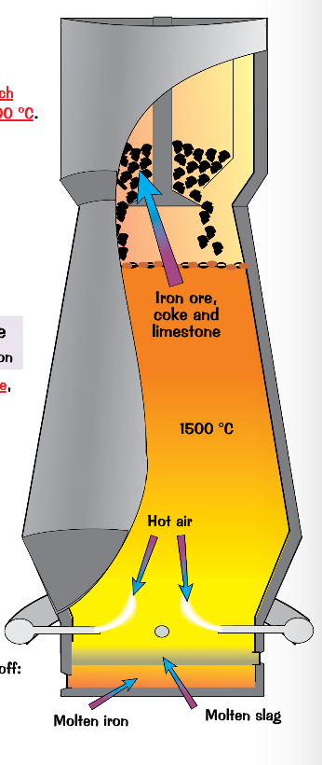
10.1 Metals

Slide 52
10.1 Properties of metals
List the general physical properties of metals
Describe the general chemical properties of metals e.g. reaction with dilute acids and reaction with oxygen
Explain in terms of their properties why alloys are used instead of pure metals
Identify representations of alloys from diagrams of structure

Slide 53
10.1 Properties of metals
List the general physical properties of metals
Describe the general chemical properties of metals e.g. reaction with dilute acids and reaction with oxygen
Explain in terms of their properties why alloys are used instead of pure metals
Identify representations of alloys from diagrams of structure

Slide 54
10.2 Reactivity series
Place in order of reactivity: potassium, sodium, calcium, magnesium, zinc, iron, (hydrogen) and copper, by reference to the reactions, if any, of the metals with:
– water or steam
– dilute hydrochloric acid and the reduction of their oxides with carbon
Describe the reactivity series as related to the tendency of a metal to form its positive ion, illustrated by its reaction, if any, with:
– the aqueous ions
– the oxides of the other listed metals

Slide 55
10.2 Reactivity series
Describe and explain the action of heat on the hydroxides, carbonates and nitrates of the listed metals
Account for the apparent unreactivity of aluminium in terms of the oxide layer which adheres to the metal
Deduce an order of reactivity from a given set of experimental results

Slide 56
10.3 Extraction of metals
Describe the ease in obtaining metals from their ores by relating the elements to the reactivity series
Describe and state the essential reactions in the extraction of iron from hematite
Describe the conversion of iron into steel using basic oxides and oxygen
Know that aluminium is extracted from the ore bauxite by electrolysis
Discuss the advantages and disadvantages of recycling metals, limited to iron/steel and aluminium

Slide 57
Year 9 Cover Work Period 4 21/10/15
Task 1
Turn to page 78 in your textbook and complete the checkpoint exercise.
(20-30 minutes depending on ability)
Task 2
Using one of the iGCSE textbooks research the extraction of iron.
List the word and symbol equations for the reactions in the process.
Draw a diagram of the equipment used (pencil and ruler needed, full page diagram. (10-20 minutes)
Any device research is at the discretion of Mrs Magar.
Task 3
Brainstorm in your book the advantages and disadvantages of recycling metals e.g. aluminium. You might want to use the textbooks to help you.
Extension: Why don’t we recycle much iron? (10 minutes)

Slide 58
10.3 Extraction of metals
Describe in outline, the extraction of zinc from zinc blende
Describe in outline, the extraction of aluminium from bauxite including the role of cryolite and the reactions at the electrodes

Slide 59
10.4 Uses of metals
Name the uses of aluminium:
– in the manufacture of aircraft because of its strength and low density
– in food containers because of its resistance to corrosion
Name the uses of copper related to its properties (electrical wiring and in cooking utensils)
Explain the uses of zinc for galvanising and for making brass

Slide 60
10.4 Uses of metals
Name the uses of mild steel (car bodies and machinery) and stainless steel (chemical plant and cutlery)
Describe the idea of changing the properties of iron by the controlled use of additives to form steel alloys

Slide 61
11. Air and Water

Slide 62
11.1 Water
Describe chemical tests for water using cobalt(II) chloride and copper(II) sulfate
Describe, in outline, the treatment of the water supply in terms of filtration and chlorination
Name some of the uses of water in industry and in the home
Discuss the implications of an inadequate supply of water, limited to safe water for drinking and water for irrigating crops

Slide 63
11.2 Air
State the composition of clean, dry air as being approximately 78% nitrogen, 21% oxygen and the remainder as being a mixture of noble gases and carbon dioxide
Describe the separation of oxygen and nitrogen from liquid air by fractional distillation

Slide 64
11.2 Air
Name the common pollutants in the air as being carbon monoxide, sulfur dioxide, oxides of nitrogen and lead compounds
State the source of each of these pollutants:
– carbon monoxide from the incomplete combustion of carbon-containing substances
– sulfur dioxide from the combustion of fossil fuels which contain sulfur compounds (leading to ‘acid rain’)
– oxides of nitrogen from car engines
– lead compounds from leaded petrol
State the adverse effect of these common pollutants on buildings and on health and discuss why these pollutants are of global concern
Describe and explain the presence of oxides of nitrogen in car engines and their catalytic removal

Slide 65
11.2 Air
State the conditions required for the rusting of iron
Describe and explain methods of rust prevention, specifically paint and other coatings to exclude oxygen
Describe and explain sacrificial protection in terms of the reactivity series of metals and galvanising as a method of rust prevention

Slide 66
11.3 Nitrogen and fertilisers
Describe the need for nitrogen-, phosphorus- and potassium-containing fertilisers
Describe the displacement of ammonia from its salts
Describe and explain the essential conditions for the manufacture of ammonia by the Haber process including the sources of the hydrogen and nitrogen, i.e. hydrocarbons or steam and air

Slide 67
11.4 Carbon dioxide and methane
State that carbon dioxide and methane are greenhouse gases and explain how they may contribute to climate change
State the formation of carbon dioxide:
– as a product of complete combustion of carbon- containing substances
– as a product of respiration
– as a product of the reaction between an acid and a carbonate
– from the thermal decomposition of a carbonate
State the sources of methane, including decomposition of vegetation and waste gases from digestion in animals
Describe the carbon cycle, in simple terms, to include the processes of combustion, respiration and photosynthesis

Slide 68
12. Sulfur

Slide 69
12. Sulfur
Name some sources of sulfur
Name the use of sulfur in the manufacture of sulfuric acid
State the uses of sulfur dioxide as a bleach in the manufacture of wood pulp for paper and as a food preservative (by killing bacteria)
Describe the manufacture of sulfuric acid by the Contact process, including essential conditions and reactions
Describe the properties and uses of dilute and concentrated sulfuric acid

Slide 70
13. Carbonates

Slide 71
13. Carbonates
Describe the manufacture of lime (calcium oxide) from calcium carbonate (limestone) in terms of thermal decomposition
Name some uses of lime and slaked lime such as in treating acidic soil and neutralising acidic industrial waste products, e.g. flue gas desulfurisation
Name the uses of calcium carbonate in the manufacture of iron and cement

Slide 72
14. Organic chemistry

Slide 73
14.1 Names of compounds
Name and draw the structures of methane, ethane, ethene, ethanol, ethanoic acid and the products of the reactions stated in sections 14.4–14.6
State the type of compound present, given a chemical name ending in ‐ane, ‐ene, ‐ol, or ‐oic acid or a molecular structure
Name and draw the structures of the unbranched alkanes, alkenes (not cis‐ trans), alcohols and acids containing up to four carbon atoms per molecule
Name and draw the structural formulae of the esters which can be made from unbranched alcohols and carboxylic acids, each containing up to four carbon atoms

Slide 74
14.2 Fuels
Name the fuels: coal, natural gas and petroleum
Name methane as the main constituent of natural gas
Describe petroleum as a mixture of hydrocarbons and its separation into useful fractions by fractional distillation
Describe the properties of molecules within a fraction

Slide 75
14.2 Fuels
Name the uses of the fractions as:
– refinery gas for bottled gas for heating and cooking
– gasoline fraction for fuel (petrol) in cars
– naphtha fraction for making chemicals
– kerosene/paraffin fraction for jet fuel
– diesel oil/gas oil for fuel in diesel engines
– fuel oil fraction for fuel for ships and home heating systems
– lubricating fraction for lubricants, waxes and polishes
– bitumen for making roads

Slide 76
14.3 Homologous series
Describe the concept of homologous series as a ‘family’ of similar compounds with similar chemical properties due to the presence of the same functional group
Describe the general characteristics of an homologous series
Recall that the compounds in a homologous series have the same general formula
Describe and identify structural isomerism

Slide 77
14.4 Alkanes
Describe the properties of alkanes (exemplified by methane) as being generally unreactive, except in terms of burning
Describe the bonding in alkanes
Describe substitution reactions of alkanes with chlorine

Slide 78
14.5 Alkenes
Describe the manufacture of alkenes and of hydrogen by cracking
Distinguish between saturated and unsaturated hydrocarbons:
– from molecular structures
– by reaction with aqueous bromine
Describe the formation of poly(ethene) as an example of addition polymerisation of monomer units
Describe the properties of alkenes in terms of addition reactions with bromine, hydrogen and steam

Slide 79
14.6 Alcohols
Describe the manufacture of ethanol by fermentation and by the catalytic addition of steam to ethene
Describe the properties of ethanol in terms of burning
Name the uses of ethanol as a solvent and as a fuel
Outline the advantages and disadvantages of these two methods of manufacturing ethanol

Slide 80
14.7 Carboxylic acids
Describe the properties of aqueous ethanoic acid
Describe the formation of ethanoic acid by the oxidation of ethanol by fermentation and with acidified potassium manganate(VII)
Describe ethanoic acid as a typical weak acid
Describe the reaction of a carboxylic acid with an alcohol in the presence of a catalyst to give an ester

Slide 81
14.8.1 Polymers
Define polymers as large molecules built up from small units (monomers)
Understand that different polymers have different units and/or different linkages

Slide 82
14.8.2 Synthetic polymers
Name some typical uses of plastics and of man-made fibres such as nylon and Terylene
Describe the pollution problems caused by non- biodegradable plastics
Explain the differences between condensation and addition polymerisation
Deduce the structure of the polymer product from a given alkene and vice versa

Slide 83
14.8.2 Synthetic polymers
Describe the formation of nylon (a polyamide) and Terylene (a polyester) by condensation polymerisation, the structure of nylon being represented as:
and the structure of Terylene as:

Slide 84
14.8.3 Natural polymers
Name proteins and carbohydrates as constituents of food
Describe proteins as possessing the same (amide) linkages as nylon but with different units
Describe the structure of proteins as:

Slide 85
14.8.3 Natural polymers
Describe the hydrolysis of proteins to amino acids (Structures and names are not required.)
Describe complex carbohydrates in terms of a large number of sugar units, considered as

Slide 86
14.8.3 Natural polymers
Describe the hydrolysis of proteins to amino acids (Structures and names are not required.)
Describe complex carbohydrates in terms of a large number of sugar units, considered as
joined together by condensation polymerisation
eg

Slide 87
14.8.3 Natural polymers
Describe the hydrolysis of complex carbohydrates (e.g. starch), by acids or enzymes to give simple sugars
Describe the fermentation of simple sugars to produce ethanol (and carbon dioxide) (Candidates will not be expected to give the molecular formulae of sugars.)
Describe, in outline, the usefulness of chromatography in separating and identifying the products of hydrolysis of carbohydrates and proteins

Slide 88
15. Data

Slide 89
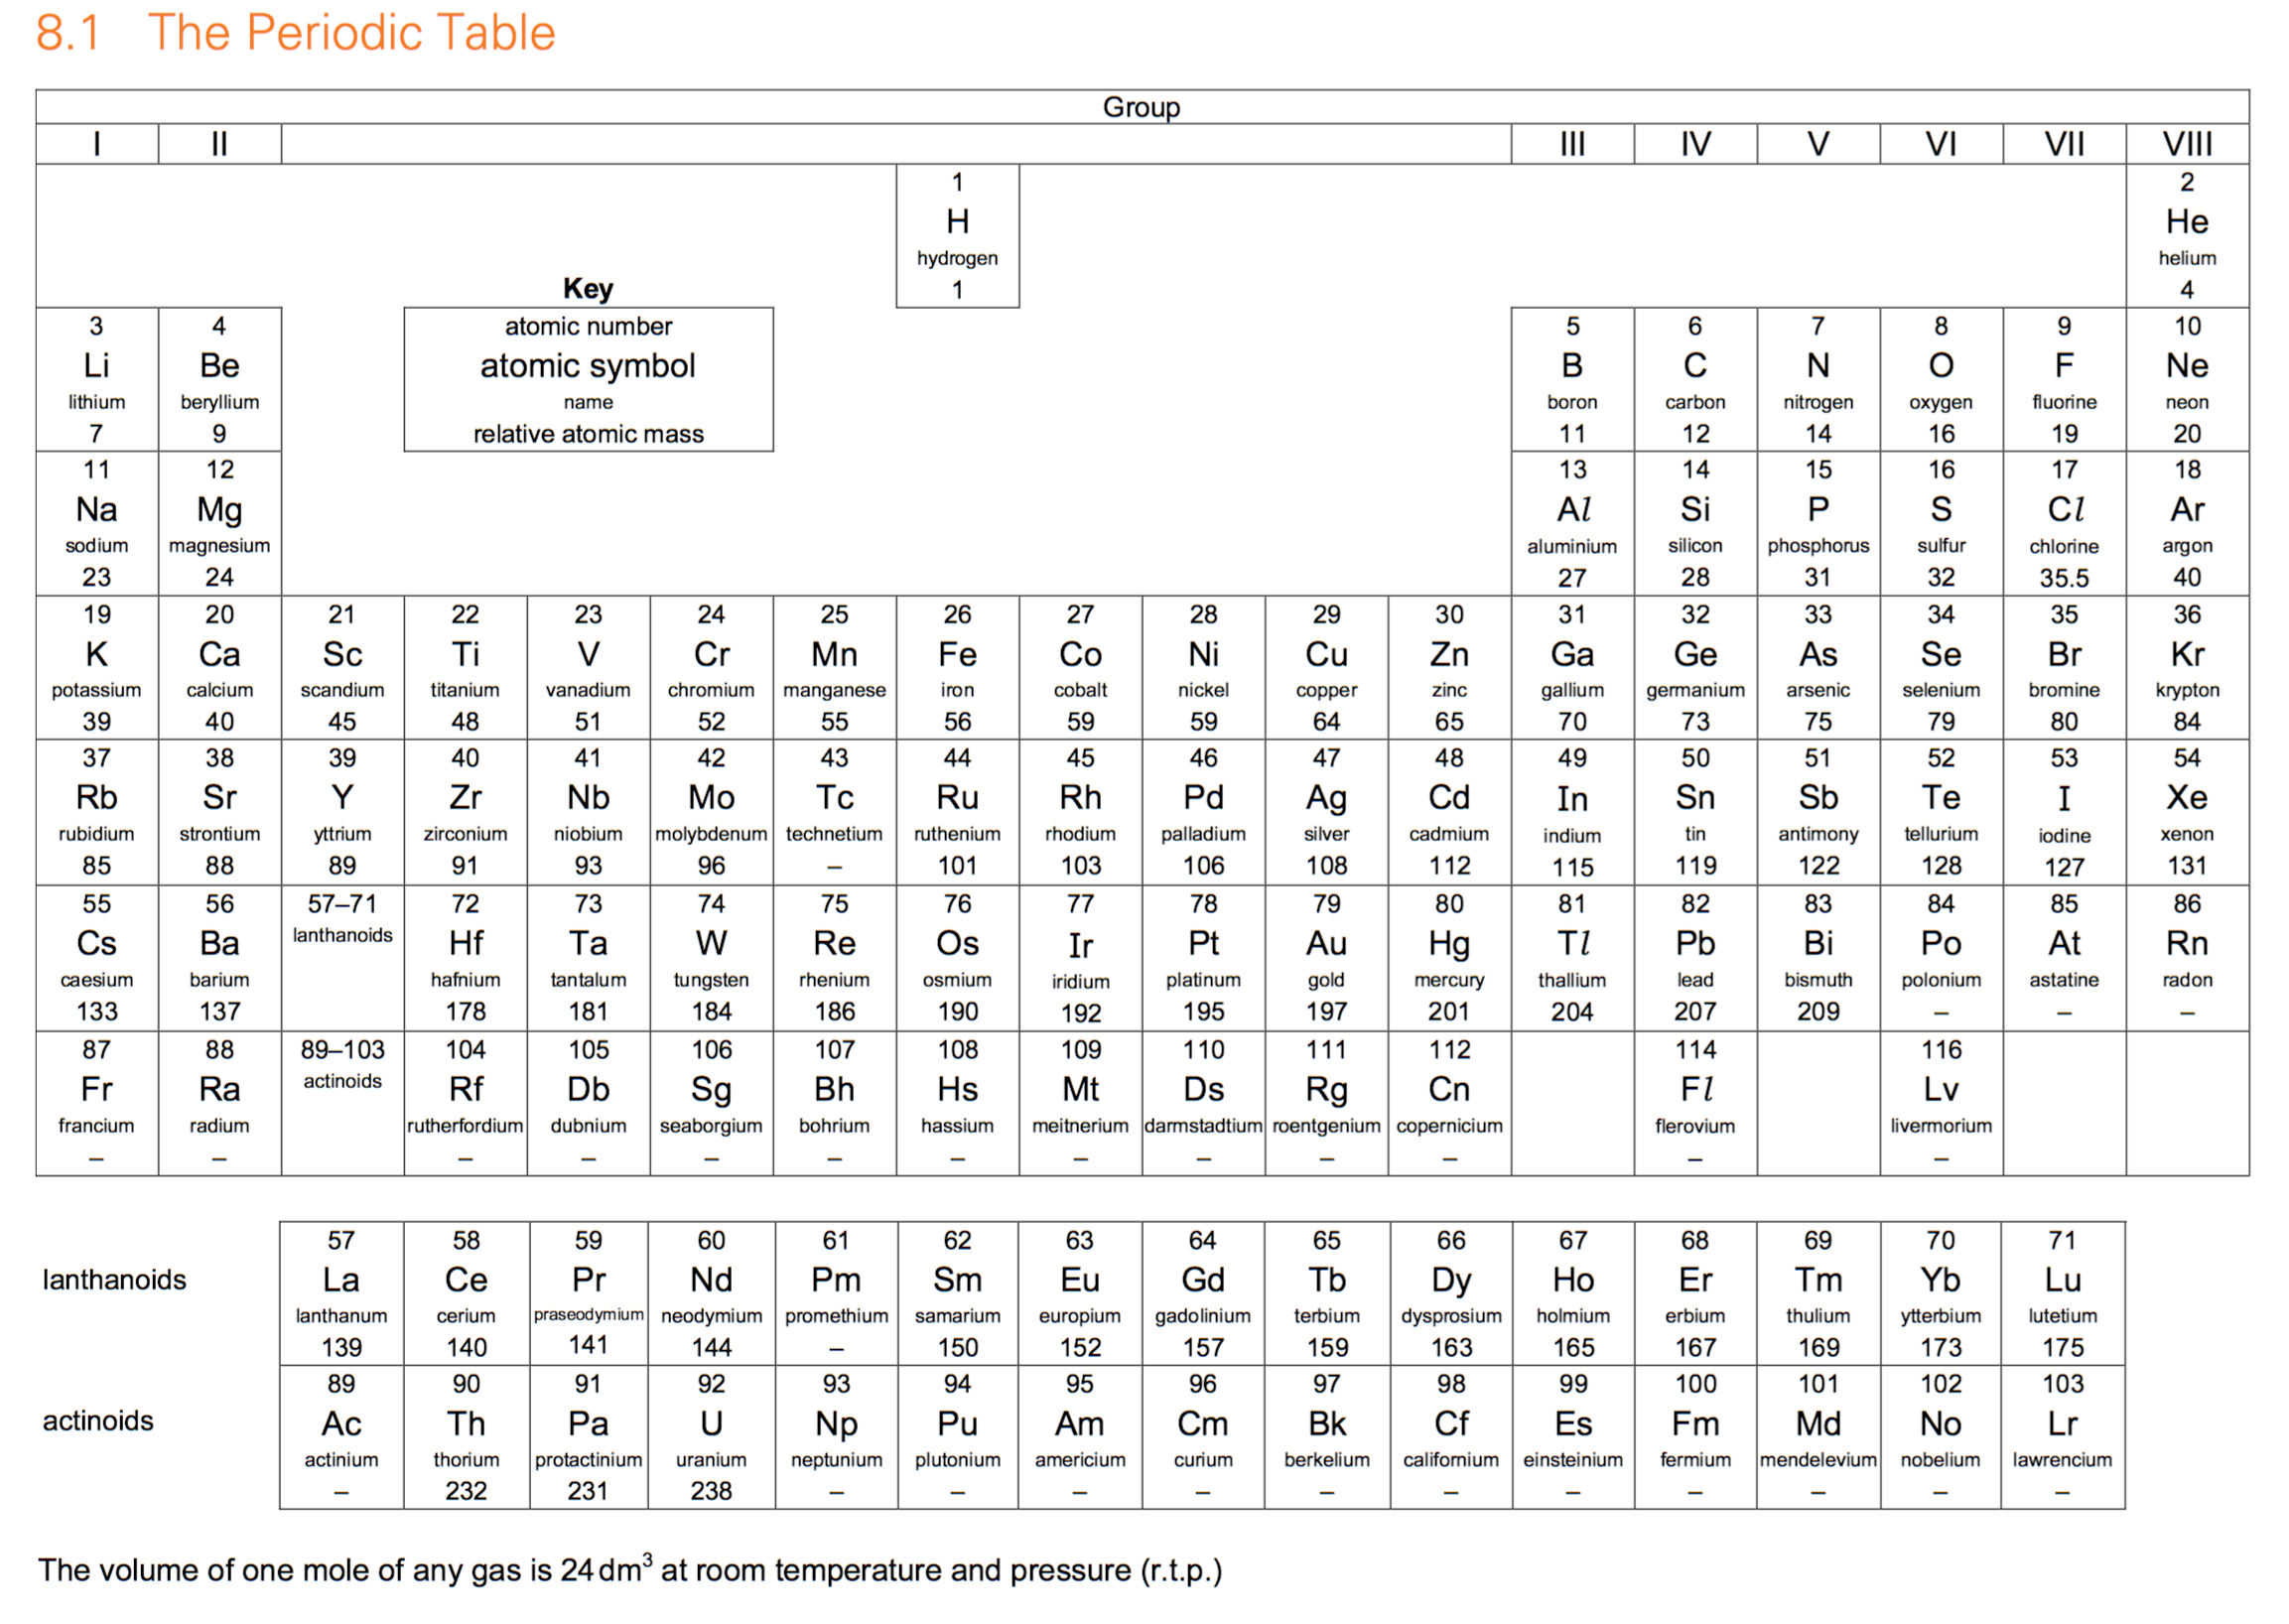
15.1 Periodic Table

Slide 90
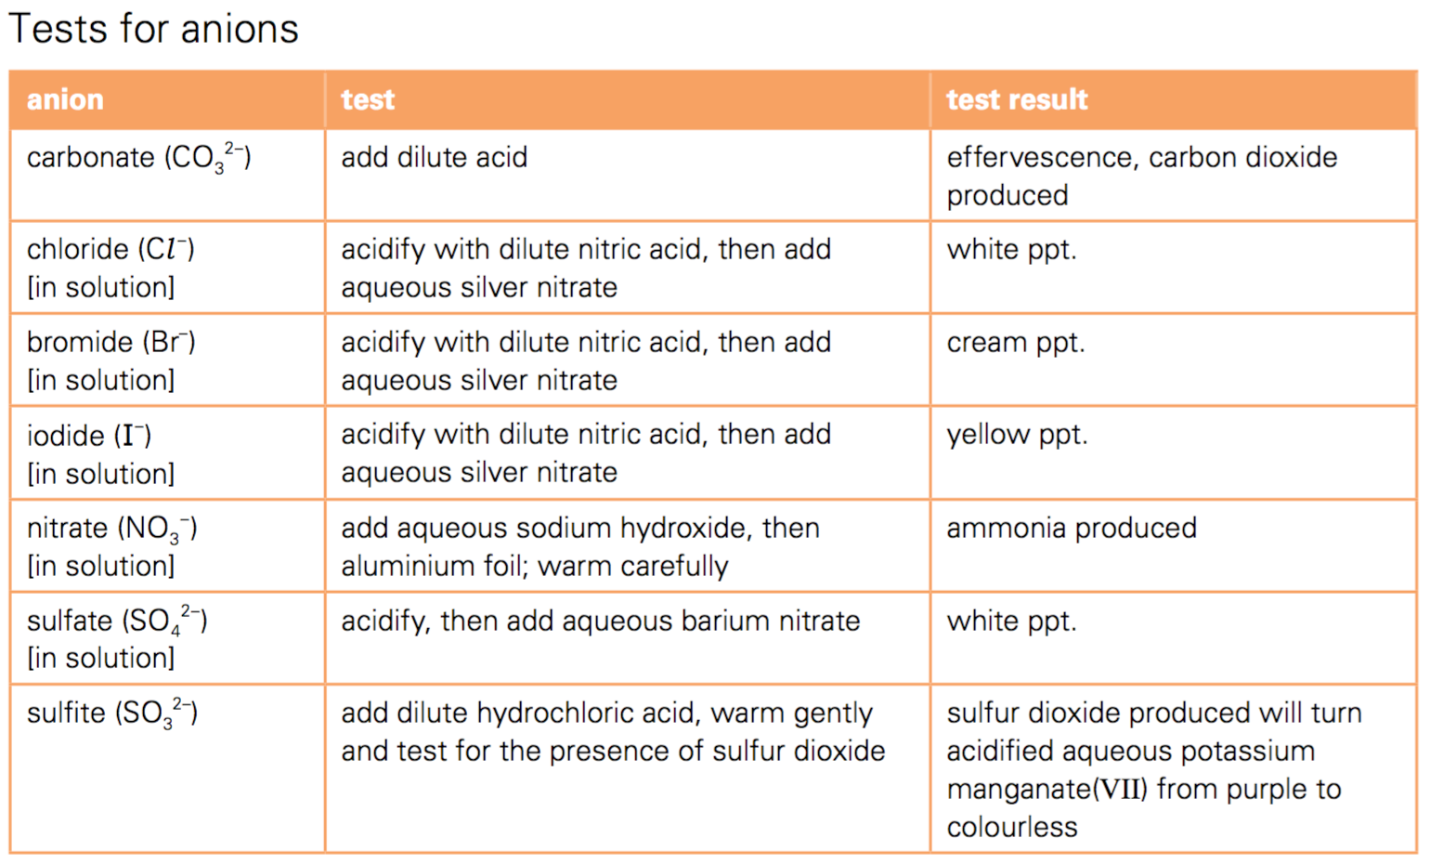
15.2 Tests

Slide 91
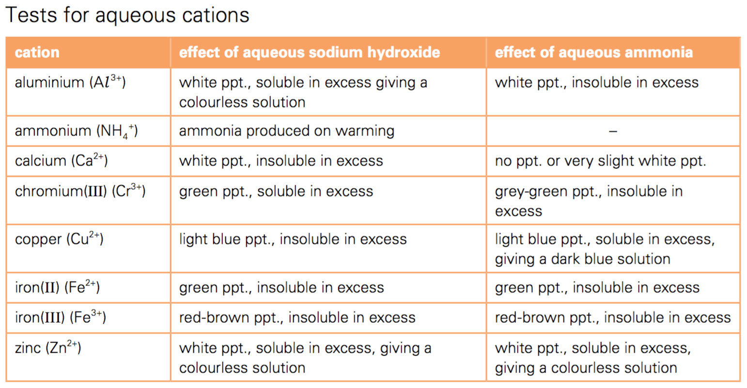
15.2 Tests

Slide 92
15.2 Tests

Slide 93
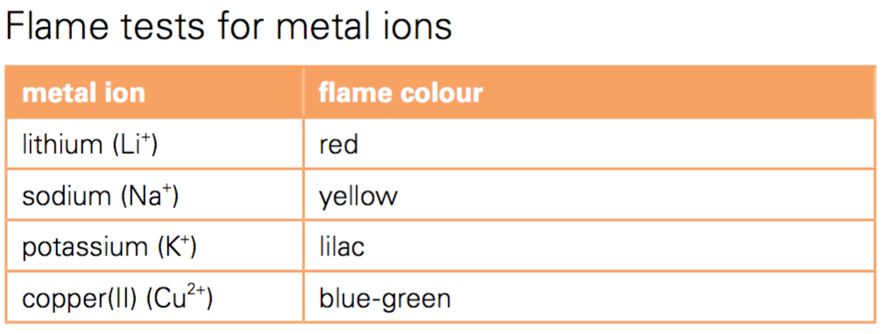
15.2 Tests

Slide 94
16. Exam Questions

Slide 95
15.1 Glossary of terms used in science papers
Define (the term(s) ... ) is intended literally, only a formal statement or equivalent paraphrase being required.
What do you understand by/What is meant by (the term(s)...) normally implies that a definition should be given, together with some relevant comment on the significance or context of the term(s) concerned, especially where two or more terms are included in the question. The amount of supplementary comment intended should be interpreted in the light of the indicated mark value. State implies a concise answer with little or no supporting argument (e.g. a numerical answer that can readily be obtained ‘by inspection’).
List requires a number of points, generally each of one word, with no elaboration. Where a given number of points is specified this should not be exceeded.
Explain may imply reasoning or some reference to theory, depending on the context. It is another way of asking candidates to give reasons. The candidate needs to leave the examiner in no doubt why something happens.

Slide 96
15.1 Glossary of terms used in science papers
Give a reason/Give reasons is another way of asking candidates to explain why something happens.
Describe requires the candidate to state in words (using diagrams where appropriate) the main points. Describe and explain may be coupled, as may state and explain. Discuss requires the candidate to give a critical account of the points involved.
Outline implies brevity (i.e. restricting the answer to giving essentials).
Predict implies that the candidate is expected to make a prediction not by recall but by making a logical connection between other pieces of information.
Deduce implies that the candidate is not expected to produce the required answer by recall but by making a logical connection between other pieces of information.
Suggest is used in two main contexts, i.e. either to imply that there is no unique answer (e.g. in chemistry, two or more substances may satisfy the given conditions describing an ‘unknown’), or to imply that candidates are expected to apply their general knowledge of the subject to a ‘novel’ situation, one that may be formally ‘not in the syllabus’ – many data response and problem solving questions are of this type.

Slide 97
15.1 Glossary of terms used in science papers
Find is a general term that may variously be interpreted as calculate, measure, determine, etc.
Calculate is used when a numerical answer is required. In general, working should be shown, especially where two or more steps are involved.
Measure implies that the quantity concerned can be directly obtained from a suitable measuring instrument (e.g. length using a rule, or mass using a balance).
Determine often implies that the quantity concerned cannot be measured directly but is obtained from a graph or by calculation.
Estimate implies a reasoned order of magnitude statement or calculation of the quantity concerned, making such simplifying assumptions as may be necessary about points of principle and about the values of quantities not otherwise included in the question.
Sketch, when applied to graph work, implies that the shape and/or position of the curve need only be qualitatively correct, but candidates should be aware that, depending on the context, some quantitative aspects may be looked for (e.g. passing through the origin, having an intercept). In diagrams, sketch implies that simple, freehand drawing is acceptable; nevertheless, care should be taken over proportions and the clear exposition of important details.

Slide 98
15.2 Maths in Exams
add, subtract, multiply and divide
use averages, decimals, fractions, percentages, ratios and reciprocals
use standard notation, including both positive and negative indices
understand significant figures and use them appropriately
recognise and use direct and inverse proportion
use positive, whole number indices in algebraic expressions
draw charts and graphs from given data
interpret charts and graphs
determine the gradient and intercept of a graph
select suitable scales and axes for graphs
make approximate evaluations of numerical expressions
understand the meaning of angle, curve, circle, radius, diameter, circumference, square, rectangle and diagonal
solve equations of the form x = y + z and x = yz for any one term when the other two are known.

Slide 99
15.3 Tables
•Each column of a table should be headed with the physical quantity and the appropriate unit, e.g. time / s.
The column headings of the table can then be directly transferred to the axes of a constructed graph.

Slide 100
15.4 Graphs
Unless instructed otherwise, the independent variable should be plotted on the x-axis (horizontal axis) and the dependent variable plotted on the y-axis (vertical axis).
Each axis should be labelled with the physical quantity and the appropriate unit, e.g. time / s.
The scales for the axes should allow more than half of the graph grid to be used in both directions, and be based on sensible ratios, e.g. 2 cm on the graph grid representing 1, 2 or 5 units of the variable.
The graph is the whole diagrammatic presentation, including the best-fit line when appropriate. It may have one or more sets of data plotted on it.
Points on the graph should be clearly marked as crosses (x)
Large ‘dots’ are penalised. Each data point should be plotted to an accuracy of better than one half of each of the smallest squares on the grid.
A best-fit line (trend line) should be a single, thin, smooth straight-line or curve. The line does not need to coincide exactly with any of the points; where there is scatter evident in the data, Examiners would expect a roughly even distribution of points either side of the line over its entire length. Points that are clearly anomalous should be ignored when drawing the best-fit line.
The gradient of a straight line should be taken using a triangle whose hypotenuse extends over at least half of the length of the best-fit line, and this triangle should be marked on the graph.

Slide 101
15.5 Numerical Results
Data should be recorded so as to reflect the precision of the measuring instrument.
The number of significant figures given for calculated quantities should be appropriate to the least number of significant figures in the raw data used.

Slide 102
15.6 Pie Charts
These should be drawn with the sectors in rank order, largest first, beginning at ‘noon’ and proceeding clockwise. Pie charts should preferably contain no more than six sectors.

Slide 103
15.7 Bar Charts
These should be drawn when one of the variables is not numerical.
They should be made up of narrow blocks of equal width that do not touch.

Slide 104
15.8 Histograms
These are drawn when plotting frequency graphs with continuous data. The blocks should be drawn in order of increasing or decreasing magnitude and they should touch.

Slide 105
17. Practical Exam Questions

Slide 106
17 Practical Exam Questions
Candidates may be asked questions on the following experimental contexts:
simple quantitative experiments involving the measurement of volumes and/or masses
rates (speeds) of reaction
measurement of temperature based on a thermometer with 1°C graduations
problems of an investigatory nature, possibly including suitable organic compounds
filtration
electrolysis
identification of ions and gases

Slide 107
17 Practical Exam Questions
Candidates may be required to do the following:
take and record readings from apparatus, including:
– reading a scale with appropriate accuracy and precision
– interpolating between scale divisions
– taking repeated measurements, where appropriate
describe,explain or comment on experimental arrangements and techniques
complete tables of data, and process data, using a calculator where necessary
draw an appropriate conclusion, justifying it by reference to the data and using an appropriate explanation
interpret and evaluate observations and experimental data
plot graphs and/or interpret graphical information
identify sources of error and suggest possible improvements in procedures
plan an experiment or investigation, including making reasoned predictions of expected results and suggesting suitable apparatus and techniques.

