Slide 1
Physmath
9: Rearranging equations

Slide 2
Learning outcomes
  Level 4
  Write equations in symbol form
  Level 5
  Change the subject of an equation
  Level 6
  Calculate values after rearranging an equation

Slide 3
Match the symbol!
d
v
km
L
F
m
s
kg
g
J
kilometres
Velocity
speed
Litres
Force
metres
distance
Joules
grams
kilograms

Slide 4
Match the symbol!
d
v
km
L
F
distance
velocity
kilometres
Litres
Force
m
s
kg
g
J
metres
time
kilograms
grams
Joules

Slide 5
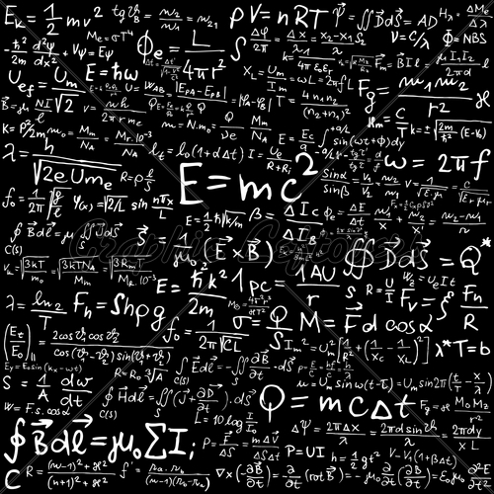
Physics equations

Slide 6
Equations are beautiful
They transform our
words into mathematics
so that we can accurately describe and predict things

Slide 7
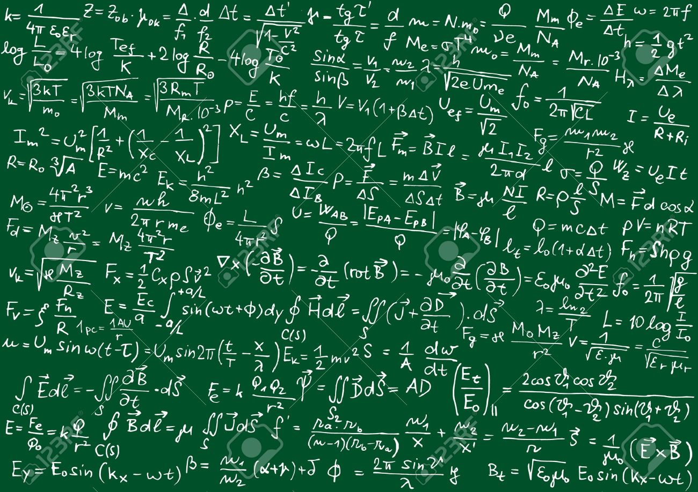

Slide 8
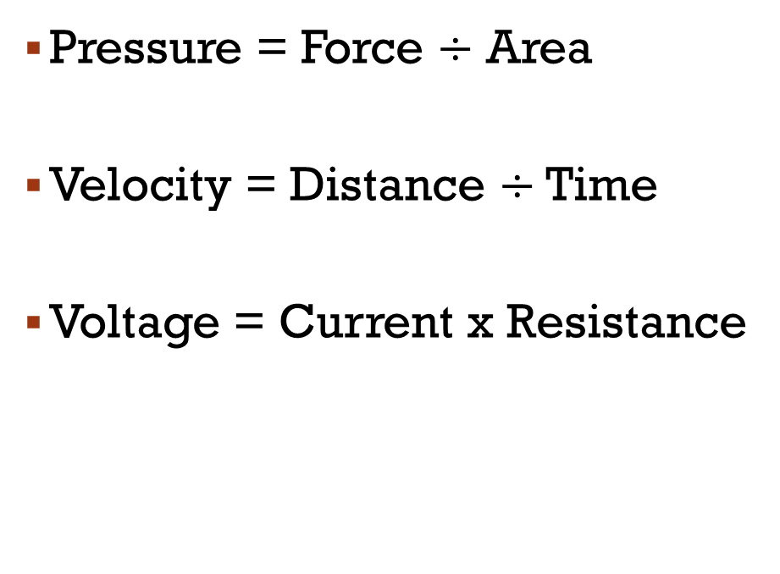
Can you change these into symbols?
Pressure = Force $÷$ Area
Velocity = Distance $÷$ Time
Voltage = Current x Resistance
Key
Pressure – P
Force – F
Area – A
Velocity – v
Distance – d
Time – t
Voltage – V
Current – I
Resistance - R

Slide 9
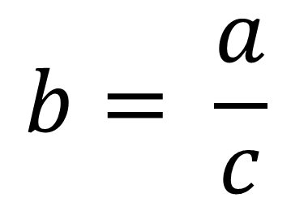
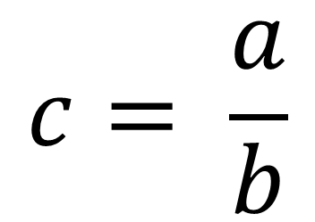
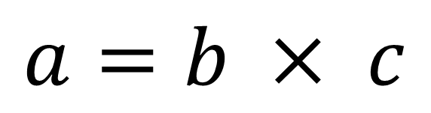
Rearranging Equations
$$a=b × c$$
$$c= \frac{a}{b}$$
$$b= \frac{a}{c}$$

Slide 10








4
5

Slide 11
4
5

Slide 12
a = 2
b = 10
w = 9
y = 5
z = 3.5
Calculate x, using the numbers on the right!

Slide 13
3
3.5
-1
1
25
6
7.5
5.75
a = 2
b = 10
w = 9
y = 5
z = 3.5

Slide 14









6

Slide 15
Summary of physmath
You’ve covered nine lessons which should have given you the basic skills you need to do Physics!
Don’t worry if you don’t feel like you understand everything yet, you’ll be practising these skills all the way through Year 7.

Slide 16


Slide 17
Summary of physmath
Without looking back in your book, write a list of every skill you can remember learning so far this term
Now share your list with your partner
  What skills did they write down that you didn’t?
  Why didn’t you write those ones down?
Go back through your book and find any skills that that you forgot to write
What skills do you need to work on most?

Slide 18

Learning outcomes
  Level 4
  Write equations in symbol form
  Level 5
  Change the subject of an equation
  Level 6
  Calculate values after rearranging an equation

