Slide 1
Chemical properties of metals
Identify the chemical properties of metals
Recognise that certain metals can form coloured compounds
Describe the reaction of metals with water
Represent reactions using word equations

Slide 3
Transition metals
Middle block of the periodic table
Form coloured compounds
Can be used as catalysts

Slide 4
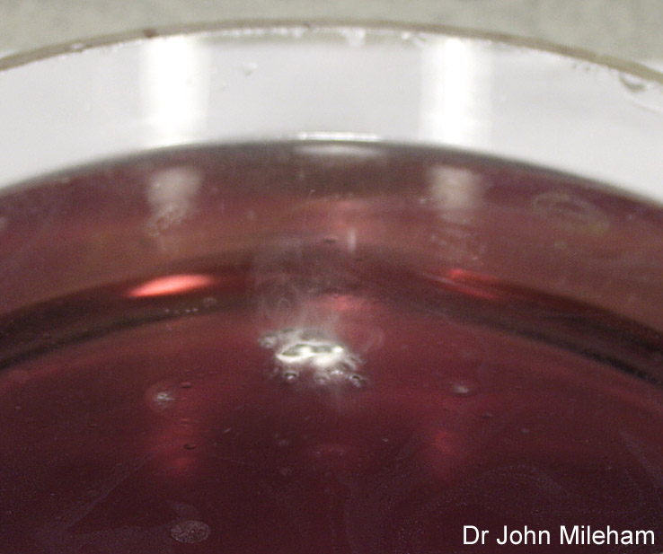
What does the reaction with water produce?
All the alkali metals react vigorously with water.
The reaction with water becomes more vigorous as you go down the group.
It is an exothermic reaction as it releases a lot of heat.
The reaction produces a gas that ignites a lighted splint with a squeaky pop. What is this gas?
When green universal indicator is added to the reaction mixture, it turns purple. What does this tell you about the products of this reaction?
Notes:
Photo credit: Dr John Mileham
Image of lithium in water, with universal indicator added. The indicator was green before the reaction, but has turned purple during the course of the reaction.

Slide 5
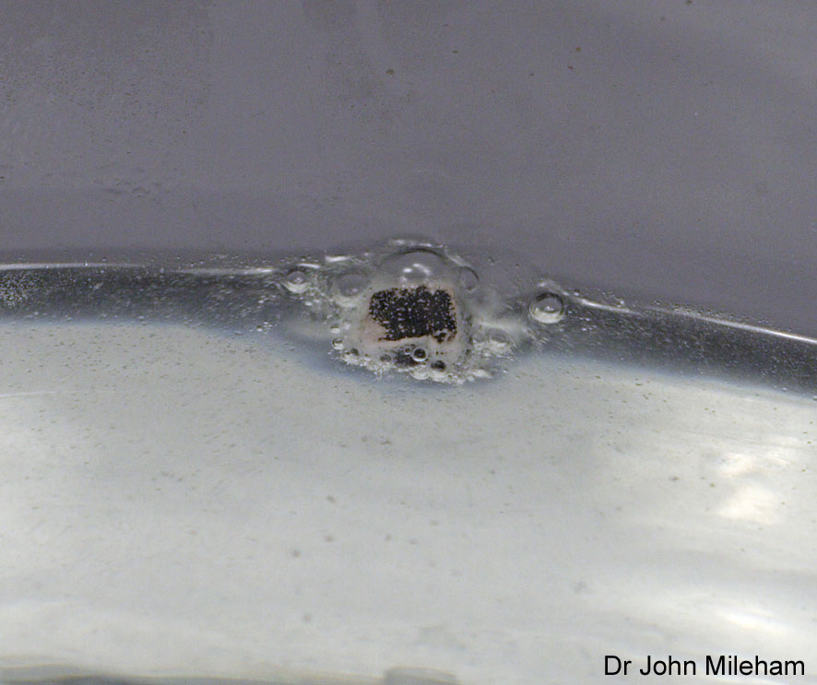
How does lithium react with water?
Lithium is the least reactive of the alkali metals.
When added to water, it fizzes and moves around slowly across the surface of the water.
What is the equation for this reaction?
lithium + water ➔ lithium + hydrogen hydroxide
2Li (s) + 2H₂O (l) ➔ 2LiOH (aq) + H₂ (g)
Notes:
Photo credit: Dr John Mileham

Slide 6
How reactive are the transition metals?
The transition metals are much less reactive than the alkali metals.
They tend to react relatively slowly, for example with air, water and acid.
Copper does not react with water whereas the alkali metals, such as sodium, react vigorously.
Copper does not burn in air whereas the alkali metals, such as sodium, burn vigorously.

Slide 7
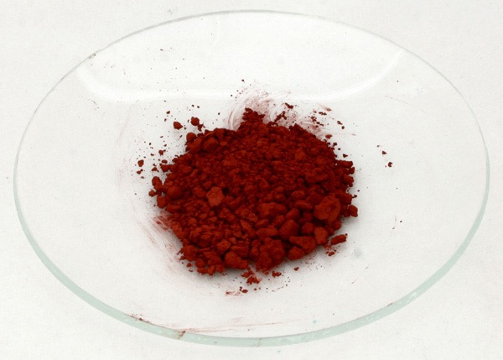
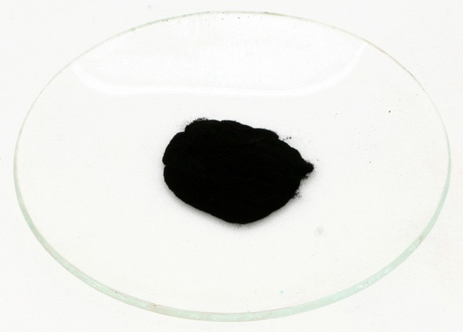
Chemical properties of transition metals
Transition metals can form coloured compounds.
For example:
Copper can form Cu⁺, which can make the red compound copper (I) oxide – Cu₂O.
Copper can also form Cu²⁺, which can make the black compound copper (II) oxide – CuO.
Notes:
Photo credit (left and right): Dr John Mileham

Slide 8
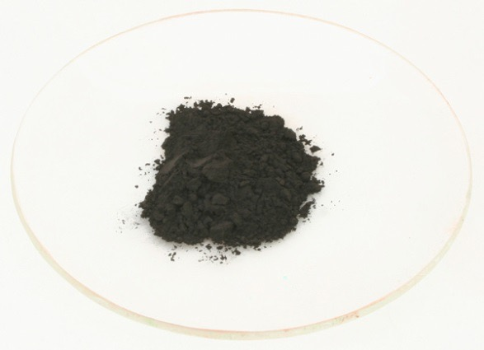
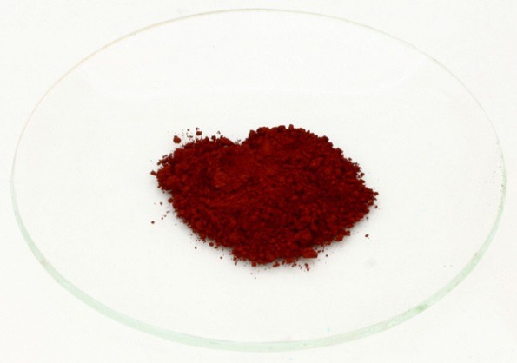
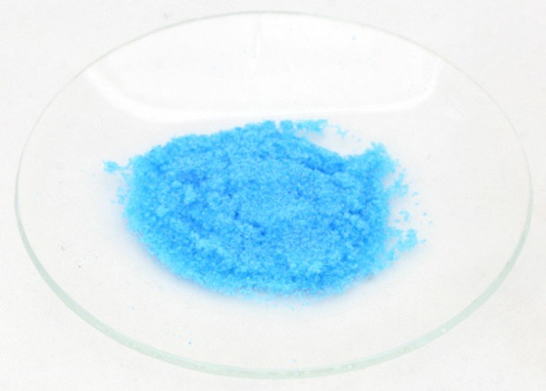
Transition metal compounds and colour
Iron (II) oxide (FeO₂) is black.
Iron (III) oxide (Fe₂O₃) is red/brown – when hydrated this is rust.
Copper (II) sulfate crystals (CuSO₄.H₂O) is blue – these can be turned white by heating the crystals to remove the water.
Notes:
Photo credit (top, middle and bottom): Dr John Mileham

